Slide 1


Recent Form Revisions
By: Ashley Strauss-Martin
NMAR, General Counsel
Click though the slides.
Most slides are “Read Only,” but three slides (8, 18 and 35) have audio.
If you wish to listen (recommended), “click” on the microphone icon.

Slide 2
List of Revised Forms
2104
1106
1108
1206
1206A
2001
4660
5116
5102
5121 *New Form – Information Sheet - Arbitration

Slide 3

FORM 2104
RESIDENTIAL PURCHASE AGREEMENT

Slide 4

Cover Pages
2104 - Residential PA
ADDED
TEAM NAME

Slide 5
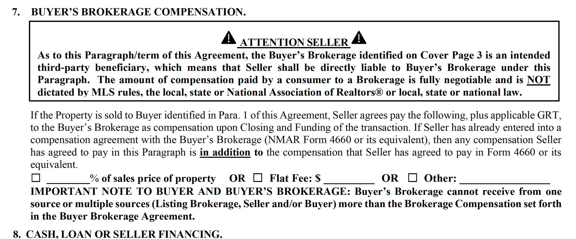
New Para. 7
Buyer Broker Compensation
No Need for Form 2301

Slide 6
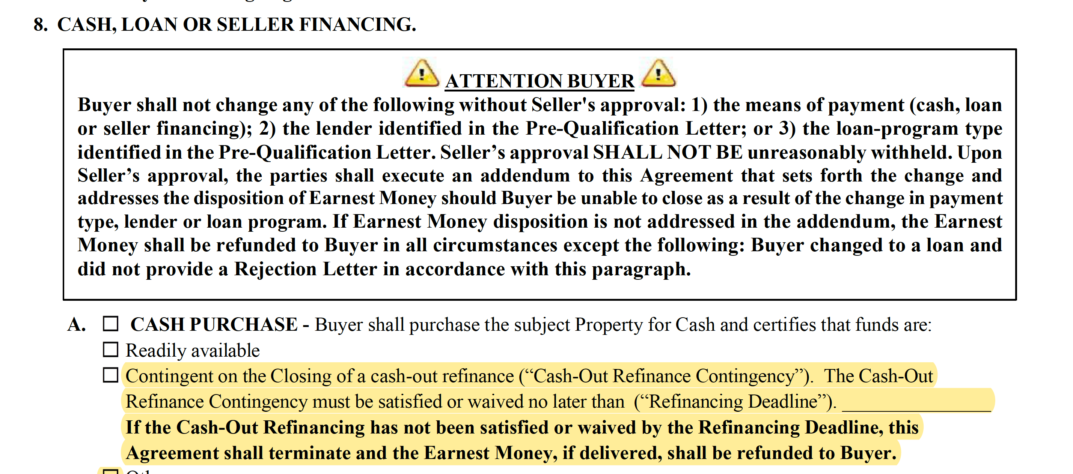
Para. 8
Cash-Out Contingency Expanded

Slide 7
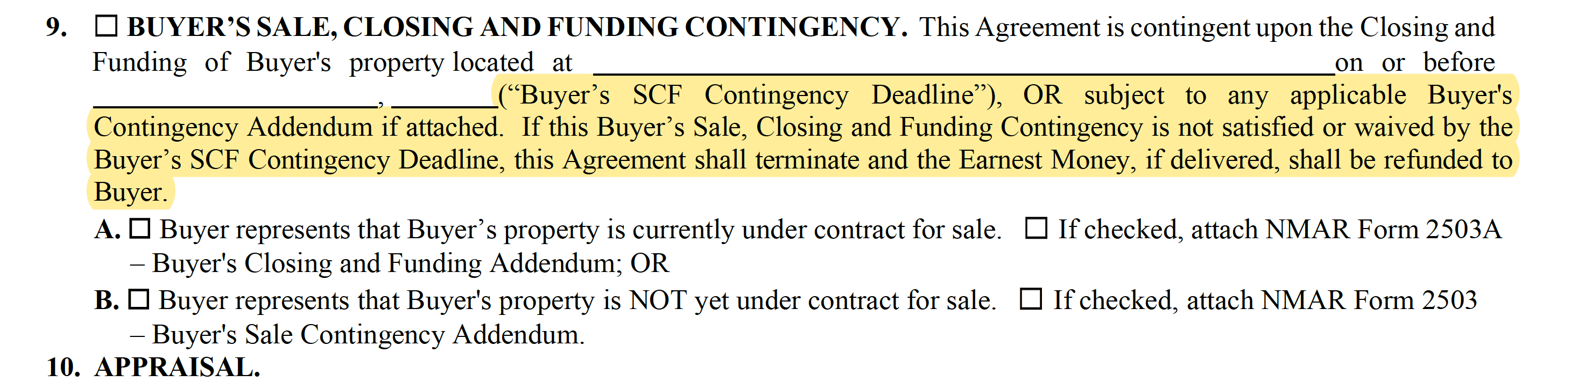
Para. 9
Addresses Earnest Money Now

Slide 8

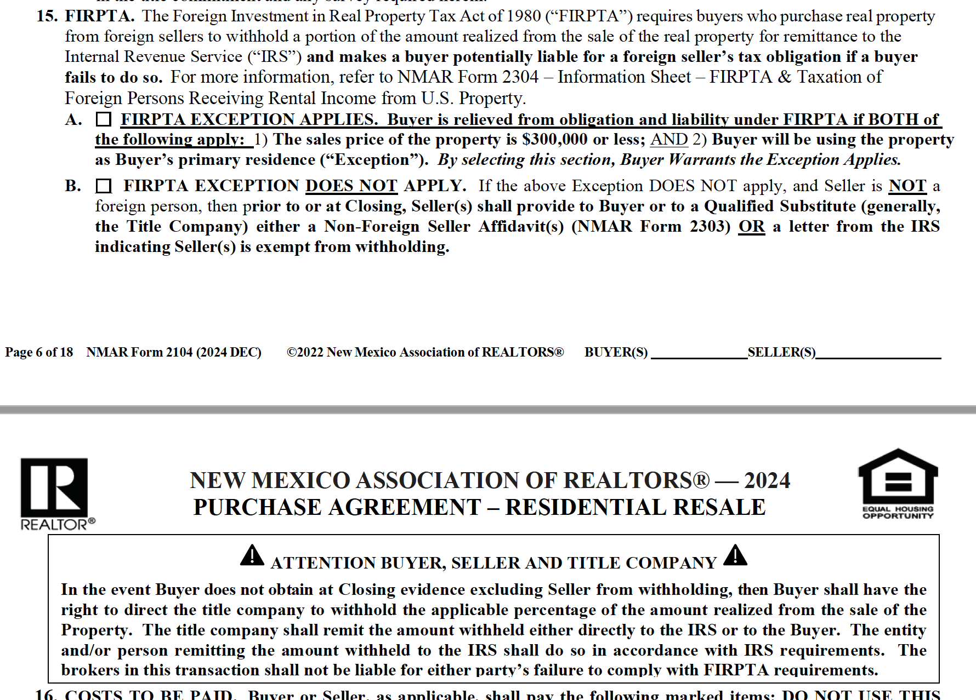


PARA. 15
For more on FIRPTA and why
I bring this up now, Click on
the microphone.
FIRPTA – Language has been altered slightly to emphasize the importance of buyer obtaining a Non-Seller Foreign Affidavit or QSS and giving buyer right to direct title company to withhold Seller’s taxes.
Read The
Box!

Slide 9
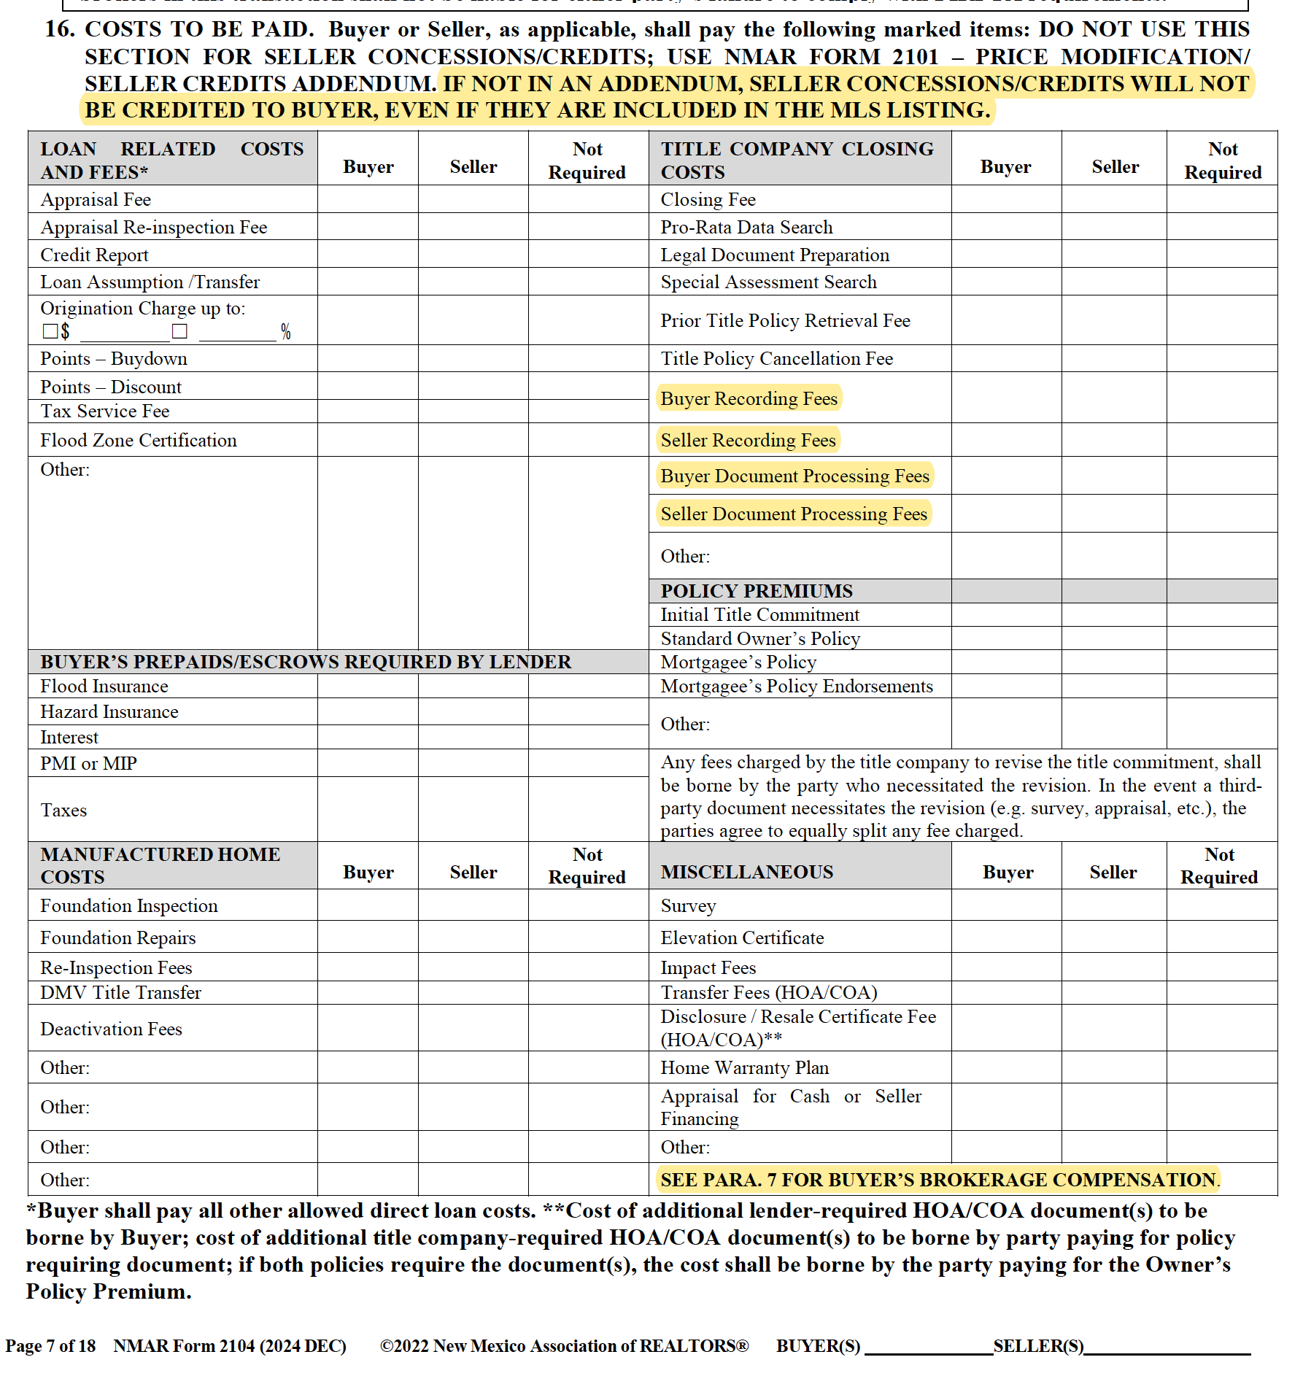

2104
All the Highlighted
Language in grid
is new or revised!

Slide 10
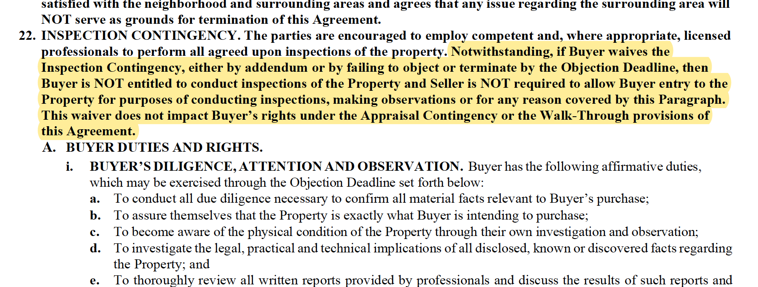
Para. 22
No Right to Inspect or to Enter Property IF Buyer Waives Inspections

Slide 11
Para. 22 (C)
Buyer’s Right to Entry Through Objection Deadline
BUYER’S ENTRY. Seller shall provide reasonable access to Buyer and Buyer’s inspectors through the Objection Deadline. Buyer shall return the Property to the condition it was in prior to any entry, test and/or inspection by Buyer. Buyer shall be liable to Seller for any damages that occur to the Property as a result of any inspection conducted by Buyer, their agents, inspectors, contractors and/or employees (collectively “Buyer’s Agents”) and Buyer agrees to hold Seller harmless, indemnify and defend Seller from any and all claims, liabilities, liens, losses, expenses (including reasonable attorneys’ fees and costs), and/or damages arising out of or related to any entry, inspections and/or tests conducted by Buyer or Buyer’s Agents. BUYER AND BUYER’S AGENTS ARE NOT PERMITTED ON THE PROPERTY WITHOUT PRIOR NOTIFICATION TO AND APPROVAL BY SELLER OR SELLER’S BROKER.

Slide 12
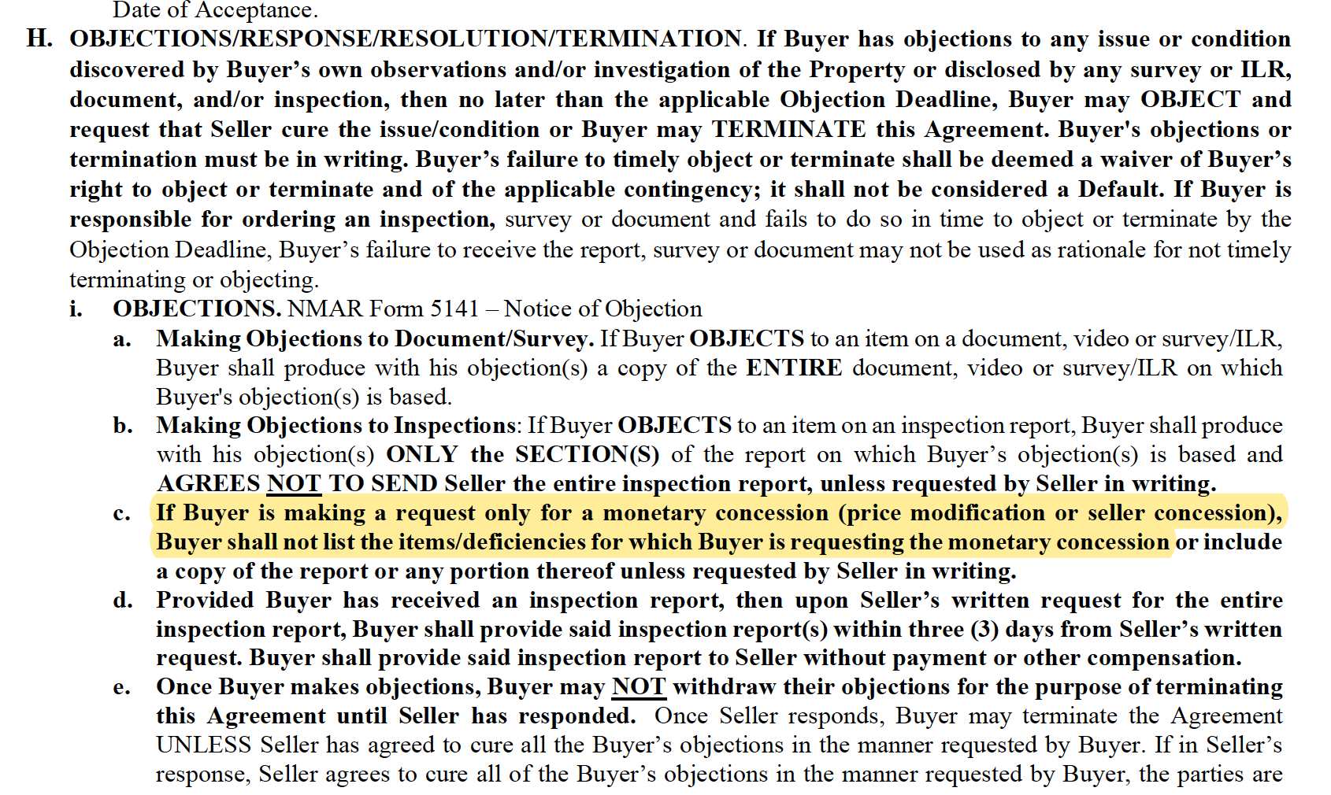
PARA. 22 – DON’T LIST Repairs In Objection Form If Just Asking For Money

Slide 13
PARA. 22
Buyer ONLY Has To Provide Report IF Termination
Is Based On Inspections (not if termination is based on other contingencies)

Slide 14
2104
Other Changes
Reordering of paragraphs/ and updating of formatting throughout
Moved “exclusions” from under ‘fixtures’ to under ‘personal property’
Removed paragraph relating to automatic extension of time for title company to issue commitment
Added more options for addendums under Para. 49

Slide 15

Form 1106 LISTING AGREEMENT

Slide 16
1106
Formerly: | New:
Exclusive Services Dual Representation Term Property Listing Price 10. Unrepresented Buyers | Exclusive Services Property Term Listing Price Dual Representation and Unrepresented Buyers
General re-formatting throughout
Reordered Paragraphs 1-5
And….

Slide 17
1106
Moved
Unrepresented
Buyer Under
Para. 5.

Slide 18

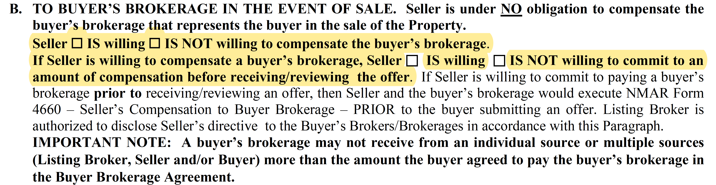
1106 – Para. 6
This is BIG!
CLICK
HERE
for AUDIO

Slide 19

1106
ARBITRATION
REQUIREMENT
added to all broker/
consumer contracts.
NOT to Purchase
Agreements.
Added requirement for brokerage and seller to arbitrate (instead of litigate)
disputes.
See NEW Arbitration Information Sheet
Notes:
This same change has been made to 1106, 1206, 1206A, and 4660

Slide 20
Form 1108
BROKERAGE TO BROKERAGE COMPENSATION AGREEMENT

Slide 21
1108
Brokerage to Brokerage Compensation Agreement
Read Language
Removed!

Slide 22

Form 1206 AND 1206A
BUYER BROKER AGREEMENTS

Slide 23

1206 – PARA. 10
OTHER POTENTIAL BUYERS. Buyer acknowledges that Broker may make known to other buyer clients or customers the same or similar properties as Buyer is seeking to acquire. Further, another buyer that Broker represents may wish to make an offer on the same property that Buyer intends to make an offer. Buyer consents to this activity and understands that Broker will not share details of Buyer's offer with the other buyer or the details of the other buyer's offer with Buyer.
ADDED
Notes:
Other Changes:
General formatting throughout
New arbitration language, as shown in 1106.

Slide 24
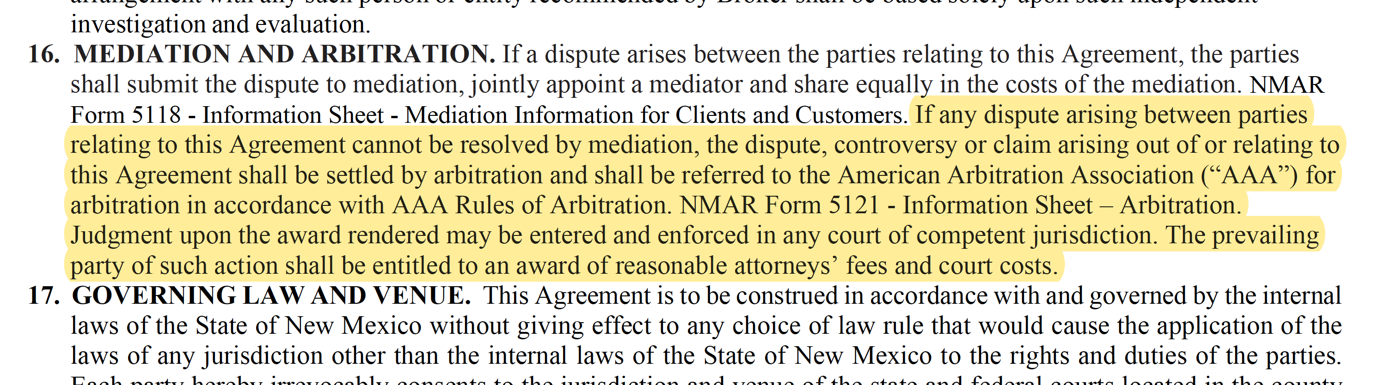
1206
Arbitration Added
Notes:
Other changes:
General formatting throughout
New arbitration language as shown in 1106

Slide 25
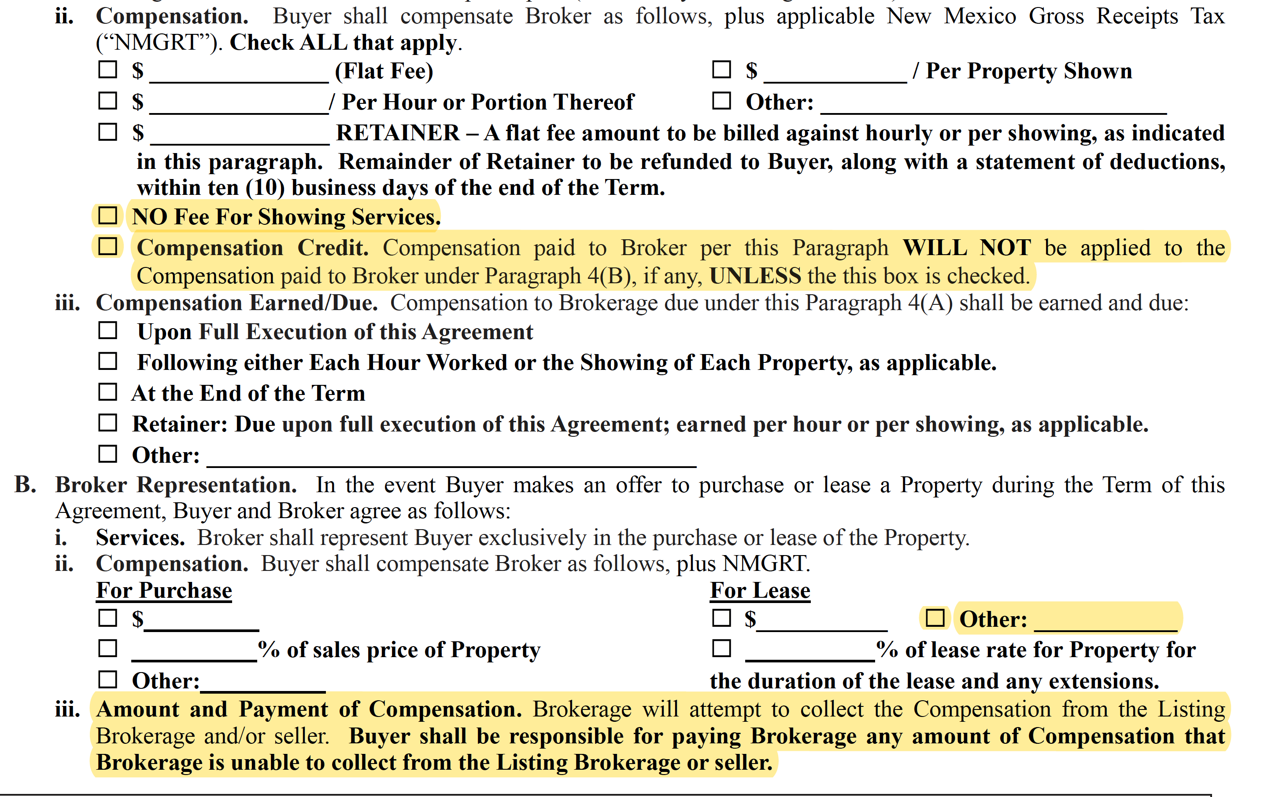
1206A –
Changes and Additions

Slide 26
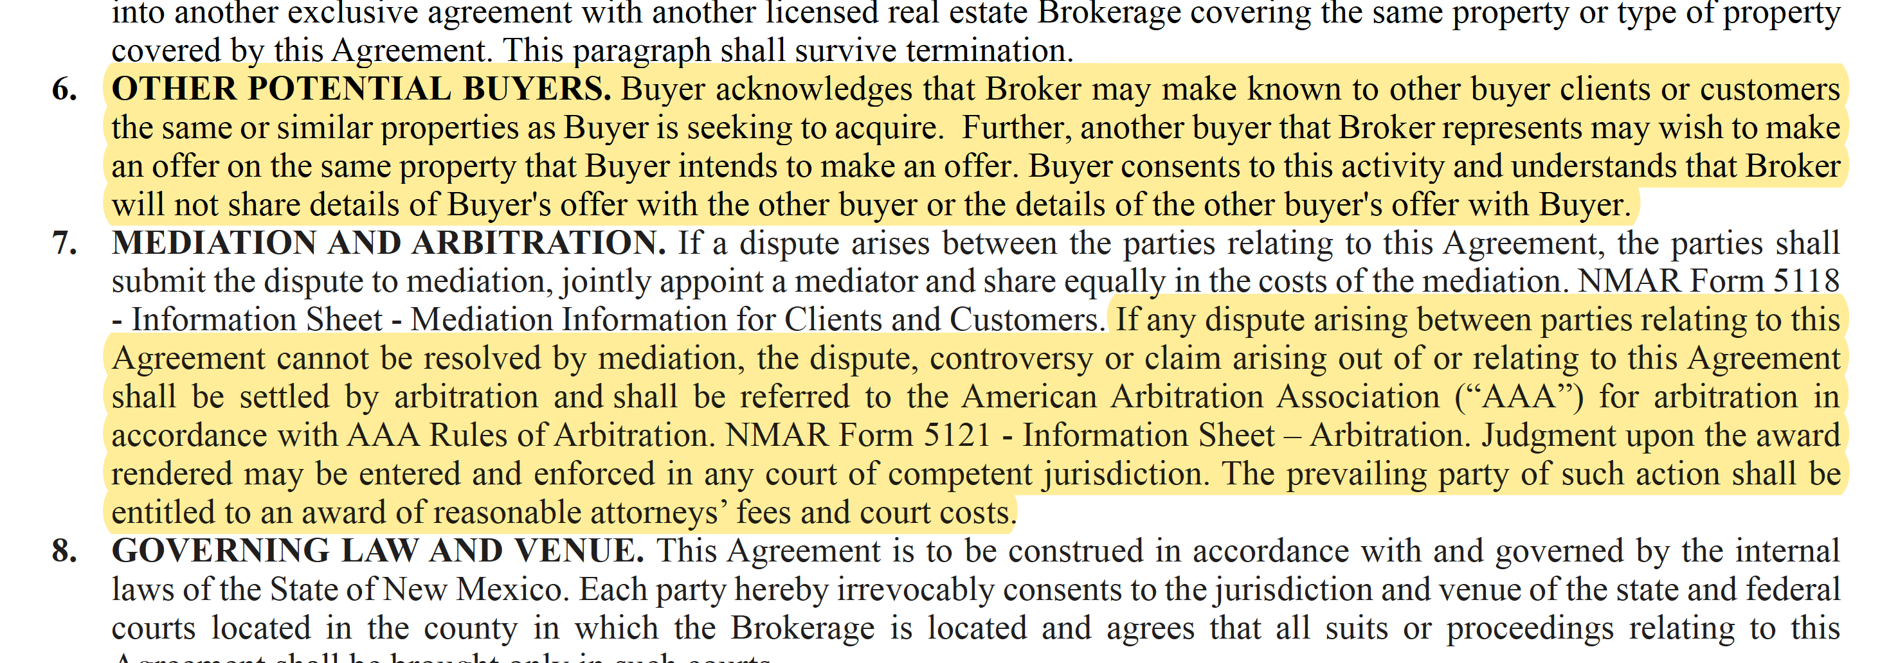
1206A:
Changes and Additions
Notes:
Other changes:
General formatting throughout
New arbitration language as shown in 1106

Slide 27
2001
BROKER COMPENSATION NOTIFICATION

Slide 28
2001
Rearranged and Seller Concession Language Added

Slide 29
FORM 4660
SELLER COMPENSATION TO BUYER’S BROKERAGE

Slide 30

4660
New
Language
Be Aware of This!
For more information
on this form, listen
to the audio on slide 18.
Only For
One
Property
Now!

Slide 31
5116
BUYER BROKERAGE AGREEMENT ADDENDUM

Slide 32
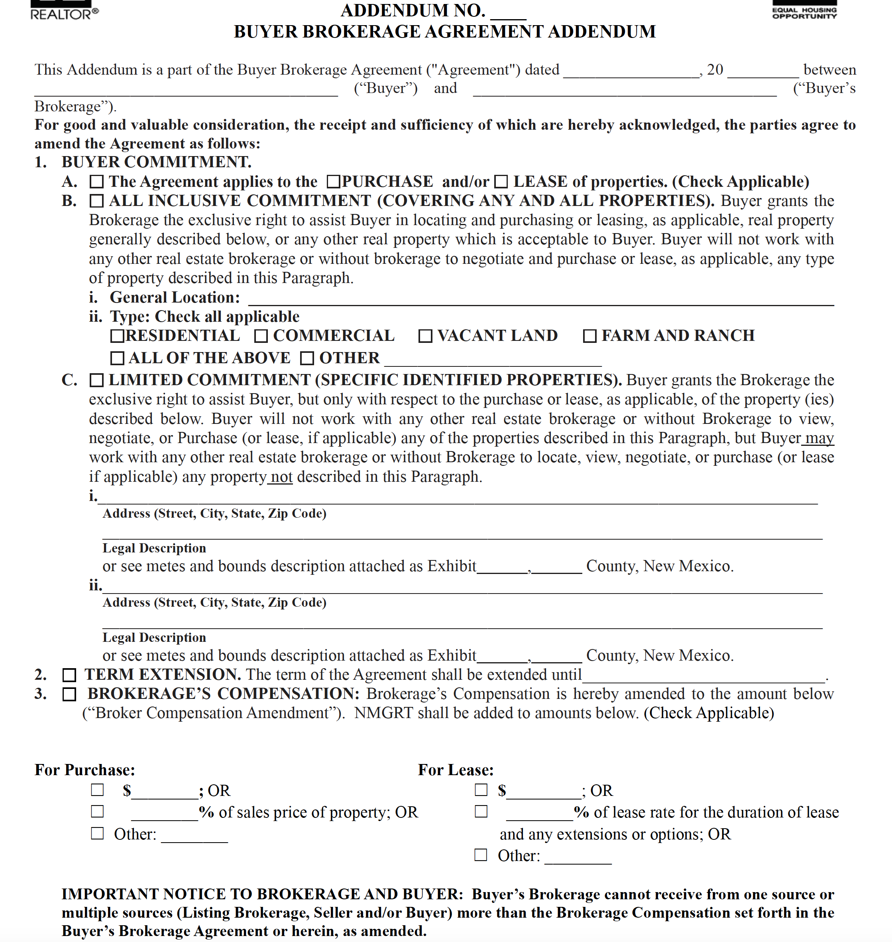
5116 – Page 1
All Potential Changes on One Addendum
Changing the level of Commitment
Extending the Term
Changing the Brokerage Compensation

Slide 33
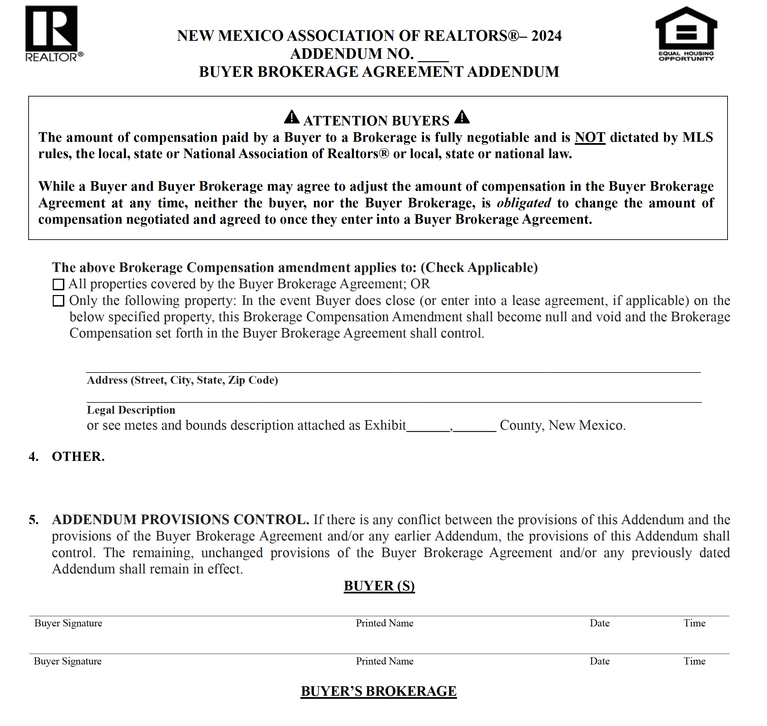

5116 – Page 2
All Potential Changes on One Addendum
Compensation change
can apply to all properties
or to one specific
property. If one property, and
deal falls apart,
compensation would return
to amount in original agreement.

Slide 34
5101
COUNTEROFFER

Slide 35
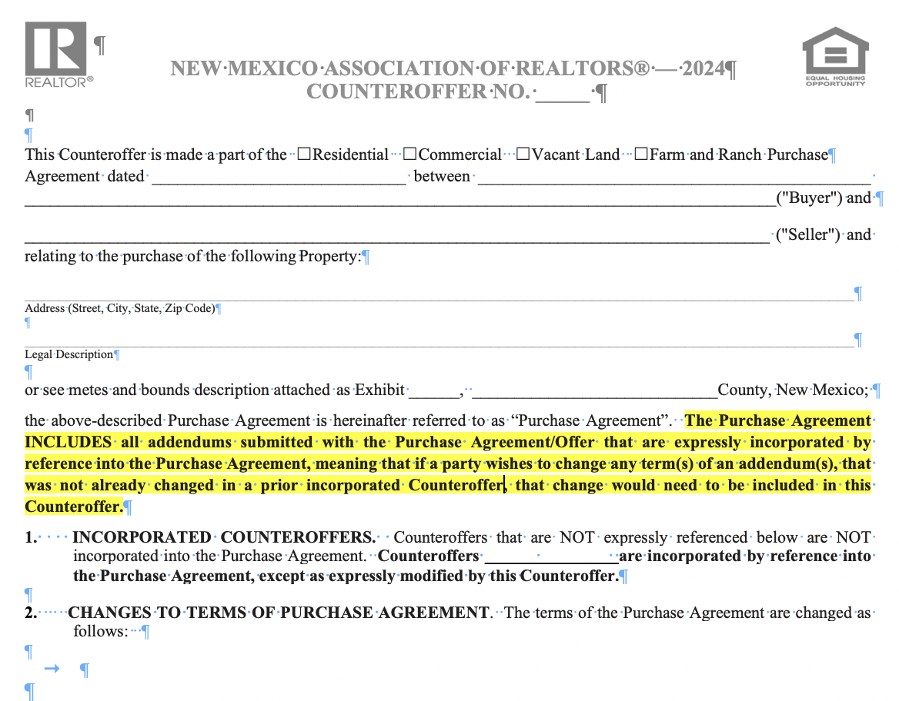
FORM 5102 Counteroffer
Worth a Listen
Click the microphone!

Slide 36
NEW FORM

Slide 37
ARBITRATION
NEW ARBITRATION INFO SHEET – FORM 5121
ADDED ARBITRATION REQUIREMENT TO ALL BROKER/CONSUMER AGREEMENTS (NOT TO PURCHASE AGREEMENT)
MEDIATION AND ARBITRATION. If a dispute arises between the parties relating to this Agreement, the parties shall submit the dispute to mediation, jointly appoint a mediator and share equally in the costs of the mediation. NOMAR Form 5118 -Information Sheet - Mediation Information for Clients and Customers. If any dispute arising between parties relating to this Agreement cannot be resolved by mediation, the dispute, controversy or claim arising out of or relating to this Agreement shall be settled by arbitration and shall be referred to the American Arbitration Association (“AAA”) for arbitration in accordance with AAA Rules of Arbitration. NMAR Form 5121 - Information Sheet – Arbitration. Judgment upon the award rendered may be entered and enforced in any court of competent jurisdiction.

Slide 38


Call/Email Me With Questions
THANK YOU!
NMAR Legal Hotline
505-821-1583
LEGALHOTLINE@NMREALTOR.COM

