Slide 3
Ranm forms update
4 CE Education
Core Elective

Slide 4
The ground rules
Cell phones on vibrate please!
If you absolutely need to take a call, please step outside
Two short breaks
The success of this class depends on YOU! You will be expected to participate!
Please remember – your side conversations are disturbing to the people around you.

Slide 5
Your navigator
Licensed Realtor since 2004
Focusing on residential sales in the Albuquerque metro
Over 280 Purchase Contracts Written and Closed
QB license, but I don’t supervise
No lawsuits. No mediations. No ethics violations

Slide 6
Introduce yourselves
Name
Brokerage
Years licensed
Specialty area (if any)
Something about you that few people know

Slide 7
Roadmap for today
Many new forms and revisions in 2018 to cover today!
2 new RANM forms released (and some revisions) on July 10, 2018
3 new RANM forms released (and some revisions) on April 16, 2018
1 new RANM form released and revisions to existing forms on Feb. 1
1 new RANM form released and revisions to existing forms on Jan. 15

Slide 8
Roadmap for today
Ongoing updates to the RANM Listing Agreement (January, March and June)
Ongoing updates to the RANM Purchase Agreement (May)
2017 Changes still relevant!
Listing Agreement, Septic, Occupancy Agreements (November 2017)
Purchase Agreements, Seller’s Disclosure (July 2017)

Slide 9
2 new ranm forms
Released July 10, 2018

Slide 13
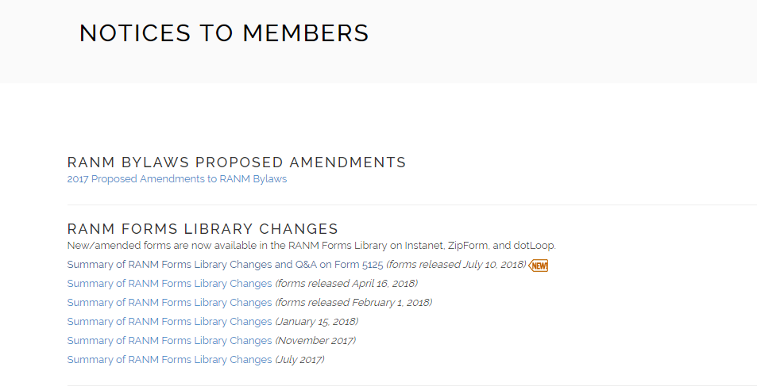

Slide 14
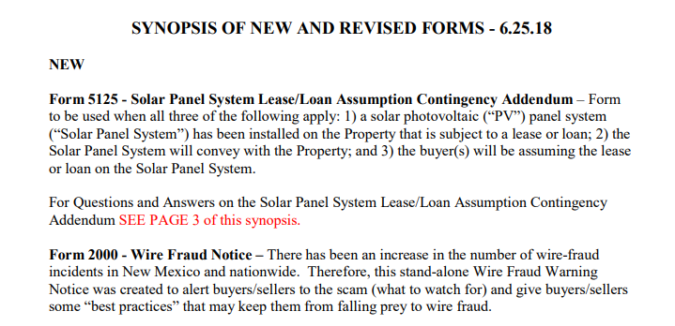

Slide 15
Wire fraud notice
RANM form 2000

Slide 16
Wire fraud notice
There has been an increase in the number of wire-fraud incidents in New Mexico and nationwide. Therefore, this stand-alone Wire Fraud Warning Notice was created to alert buyers/sellers to the scam (what to watch for) and give buyers/sellers some “best practices” that may keep them from falling prey to wire fraud.

Slide 19
Colorado Couple Loses Life Savings

Slide 20
How to contact the FBI Field Office

Slide 21
Solar panel lease/loan assumption contingency addendum
RANM Form 5125

Slide 22
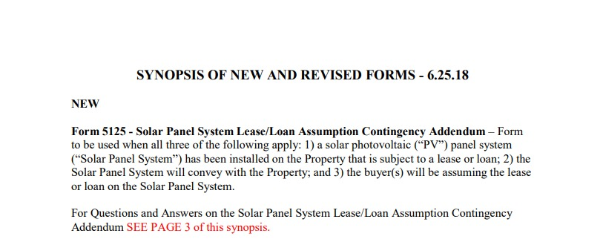

Slide 23
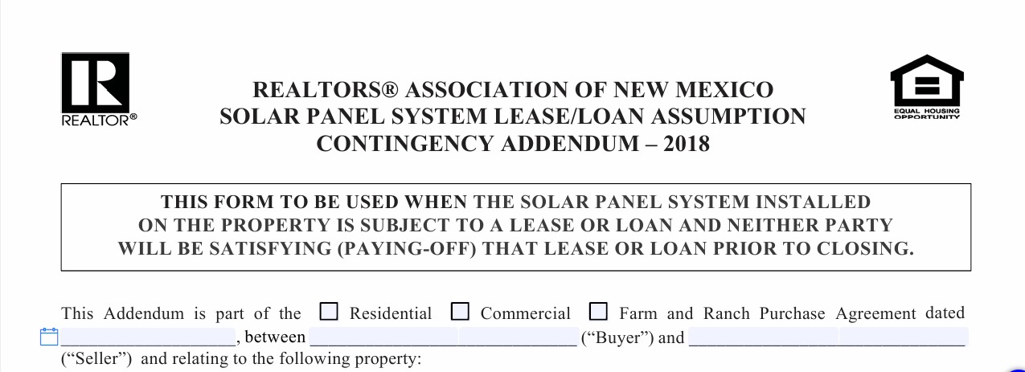

Slide 28
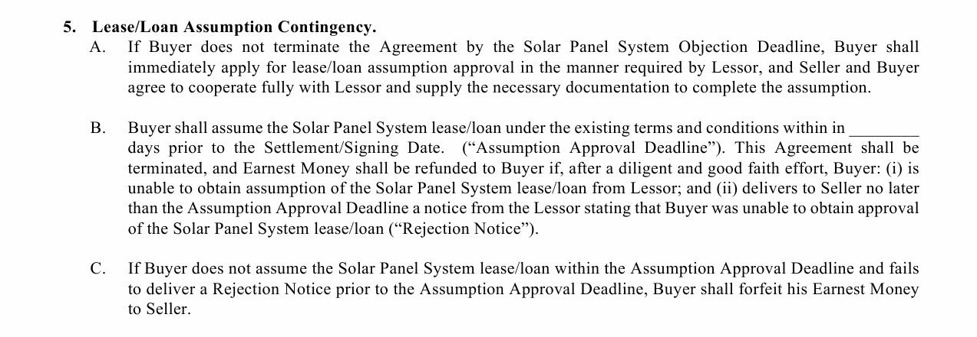

Slide 30
3 NEW ranm FORMS
Released April 16, 2018

Slide 31
Transaction coordinator agreement
RANM 1700

Slide 32
Transaction Coordinator agreement
Transaction Coordinator Agreement (Form 1700):
This Form is to be used when a Broker works with a Transaction Coordinator FROM ANOTHER BROKERAGE; the Form is NOT necessary if the Transaction Coordinator works within the same brokerage. This Form satisfies the New Mexico Real Estate Commission Regulation that requires a transaction-specific written agreement between the two brokerages that is signed by the Qualifying Brokers of both brokerages. This Agreement provides for a variety of Transaction Coordinator services, which can be individually selected.

Slide 33
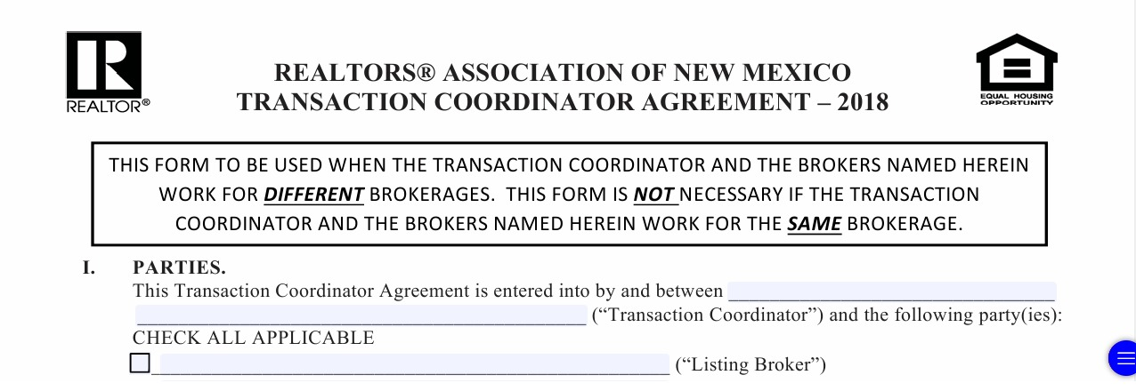

Slide 42
Prior inspection cover sheet
RANM 1750

Slide 43
Prior inspection cover sheet
Prior Inspection Cover Sheet (Form 1750):
This Form to be used as a Cover Sheet for prior inspections being provided by seller to buyer to emphasize to buyer the information found in the box in the middle of the page; there are similar notifications in Section “O” of the Seller’s Property Disclosure; however, the notifications in the Seller’s Property Disclosure can easily get overlooked due to the copious amount of information provided in the Seller’s Property Disclosure. Multiple inspections can be listed and attached to the Cover Sheet.

Slide 44
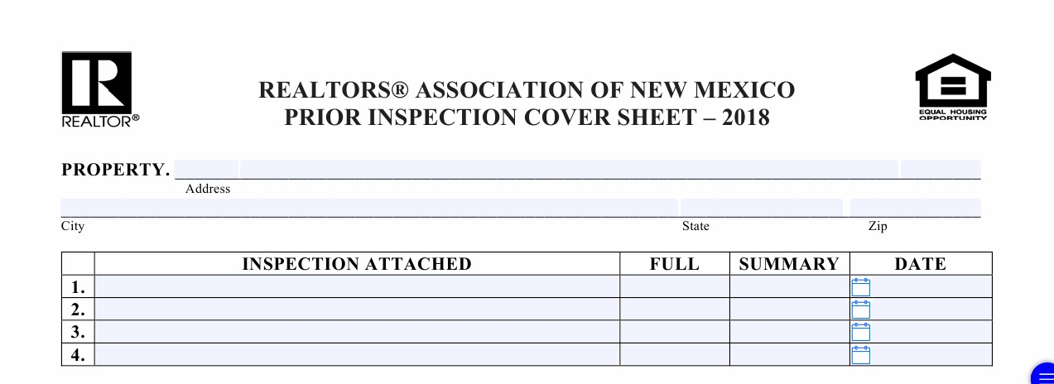

Slide 45
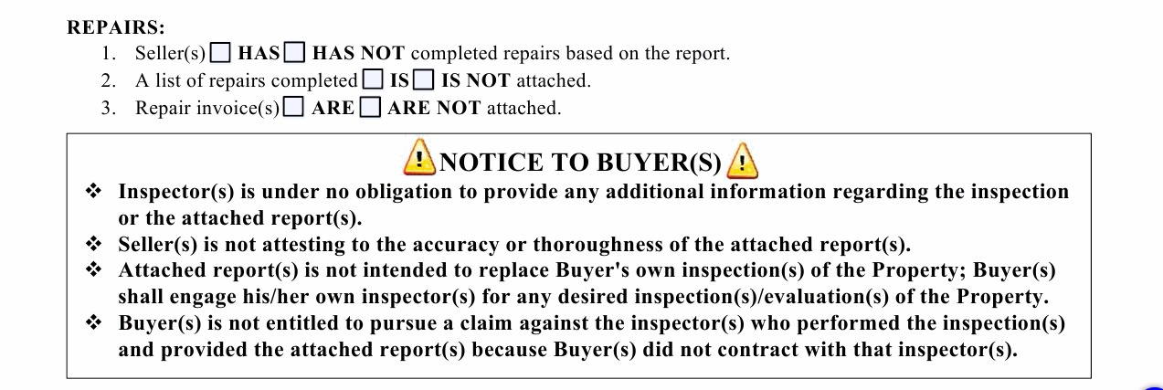

Slide 46
Bed bug addendum
RANM 6050

Slide 47
Bed bug addendum to rental agreement
Bed Bug Addendum to Residential Rental Agreement (Form 6050):
This Form to be used as an addendum to a Residential Rental Agreement. It explains how to minimize the potential of a bed-bug infestation and how a bed-bug infestation is remediated. It also sets forth tenant responsibilities aimed at avoiding and treating bed-bug infestations. The Form references a brochure published by the EPA on this subject that will be added to the RANM Forms Library as part of this Form.

Slide 48
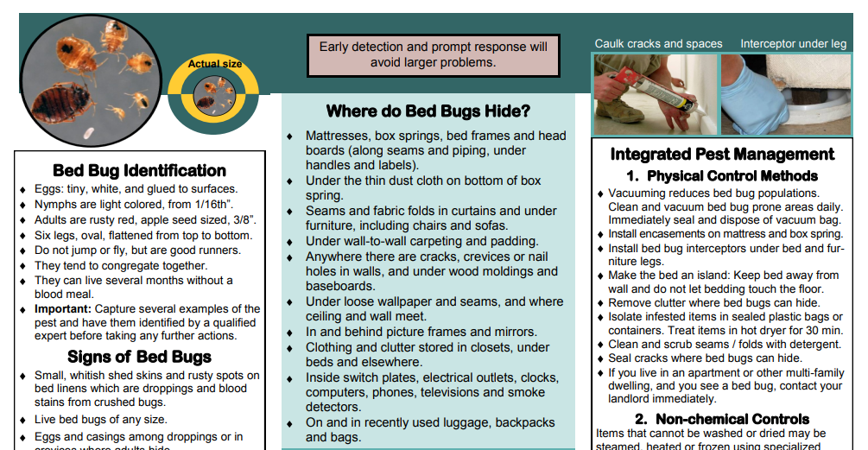

Slide 49
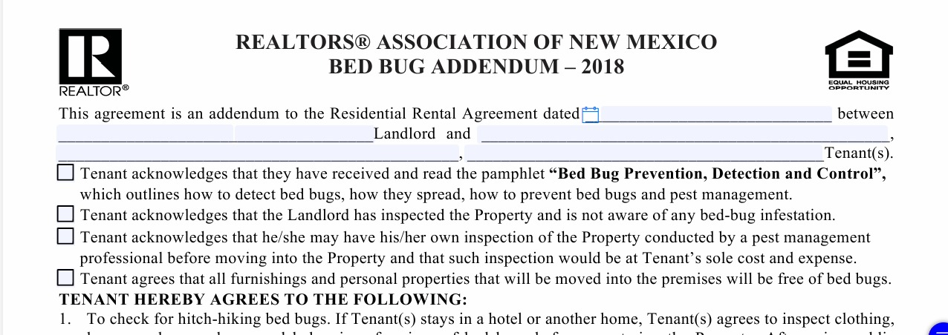

Slide 53
The new Broker Duties

Slide 54
Definition of professionalism
Ethical and Professional Conduct: conduct that a reasonable person would understand to meet standards of professionalism and ethical conduct within a profession, including, but not limited to, good faith, competence, trustworthiness, diligence and lawful behavior.

Slide 55
New Broker duty
Advice to clients and customers to consult with an attorney regarding the effectiveness, validity or consequences of any written document generated by the brokerage or presented to a prospective customer or client, and that has the potential to become an express written agreement.

Slide 56
Notes from Ashley Strauss Martin
If your client or customer has questions about the “effectiveness, validity or consequences” of the potential contract, the broker is required to advise their customer/client to speak with an attorney.
The broker’s duty to actually advise the client or customer to seek legal counsel only arises if the client or customer has questions regarding the “effectiveness, validity or consequences.”

Slide 57
supplemental Broker Duties
RANM 2100

Slide 59
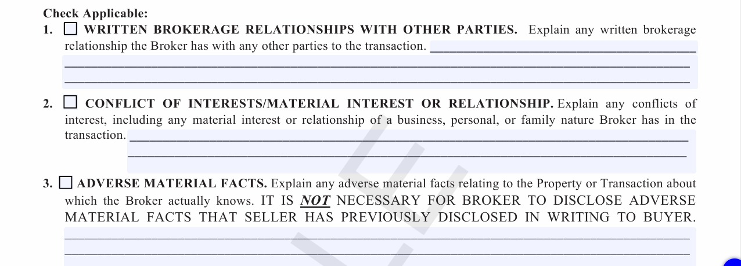

Slide 62
Listing Agreement
RANM 1106 - 2018

Slide 63
Changes to the listing agreement
Paragraph 1: Exclusive Services
Re-wording to further clarify that unless the Agreement is otherwise amended, Broker is working as a Transaction Broker for the Seller and not as an Agent and that as a Transaction Broker, the Broker owes Broker Duties, not fiduciary duties.

Slide 64
2017 Listing Agreement

Slide 65
January 2018 Listing Agreement

Slide 66
March 2018 Listing Agreement

Slide 67
June 2018 listing agreement

Slide 68
Changes to the listing agreement
Paragraph 7: Seller Obligations
To inform broker if seller is or begins using any audio or video surveillance systems in/on the Property (March 2018).

Slide 71
Changes to the listing agreement
Paragraph 8A: Seller’s Authorizations
In the event Seller is or begins using audio or video surveillance, Broker is authorized to notify other brokers and/or buyers of such use by any means appropriate as determined by Broker in Broker’s sole discretion (March 2018).

Slide 73
Changes to the listing agreement
Paragraph 8B: Seller’s Authorizations
Items previously listed in Paragraph 13A(iv) regarding the Use of Listing Content and Seller’s Grant of an intellectual Property License were moved into Paragraph 8A in January 2018 and broken down into three subsections (Paragraphs 8B(i)(ii) and (iii)). They were moved in 8B in March 2018.

Slide 74
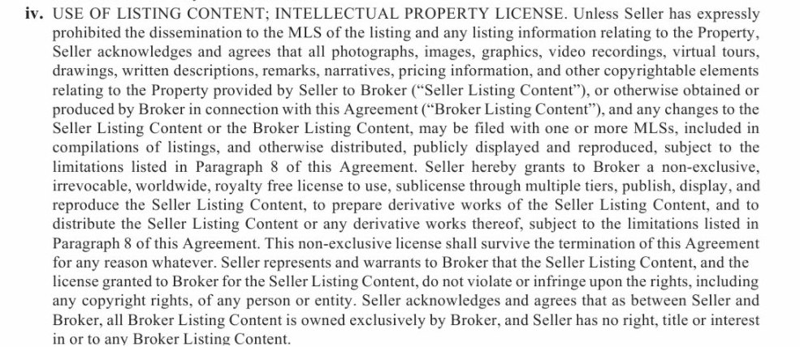

Slide 79
Changes to the listing agreement
Paragraph 8C(ii)
“consumers who conduct searches for listing on the internet will not see information about the Property in response to their searches. With the exception of removal from other MLS participants’ Internet web-sites, under NO circumstances shall Broker be responsible for removing the listing from Internet websites of on-line providers once Seller has authorized Broker and/or MLS to place Property on the Internet.”

Slide 80
Changes to the listing agreement
Paragraph 8D
Existing language was placed in its own subparagraph, which was named “Reporting False Information” and a sentence was added informing the Seller that Broker was limited or in some cases, no ability to remove false information from non-MLS participants’ websites.

Slide 82
Changes to the listing agreement
Paragraph 10
Renamed “Compensation for Sale/Transaction”

Slide 83
Changes to the listing agreement
Paragraph 10A - Addresses only the sale of the property.
Paragraph 10B – Addresses all other scenarios in which Broker would be entitled to a commission which is referred to as a “Transaction Commission;” requires the parties to enter a dollar amount or percentage owed to Broker if one of the listed events should occur and in the event the compensation is a percentage, sets forth the amount on which the percentage will be based. Listed events did not change.

Slide 84
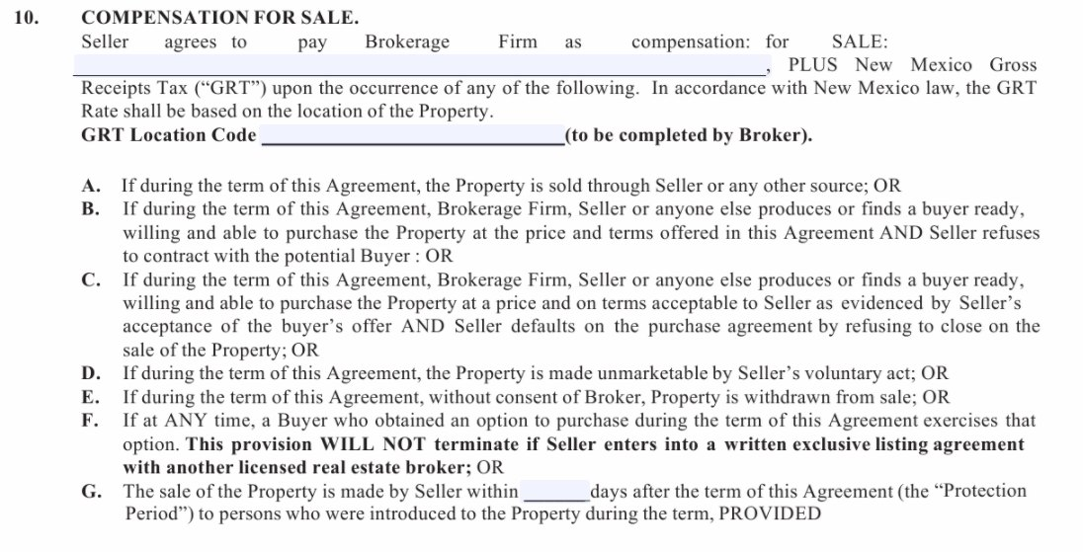

Slide 92
Transaction commissions
“Just got an update from a broker who was willing to pursue a commission in a case where the seller refused to sell (though there was a buyer willing to buy). He settled the matter with the seller (so no lawsuit) and split the settlement with the buyer's broker (listing broker a good broker), If not for the language in the listing agreement, he would have had no grounds to even pursue it. But the fact that he had grounds (based on language the LA), got the seller to settle it to avoid litigation. “
Ashley Strauss-Martin
General Counsel for the REALTORS® Association of New Mexico

Slide 93
Transaction commissions
Yes, you may share the email. And the other point I made (for separating the "other transactions" from the "compensation for sale") is that Realtors can only arbitrate for the co-op broker commission if there is an actual sale. So if one of those "other transactions" occur, there is no sale, which means there is no co-op broker owed (though, the broker to whom I was referring chose to share his settlement with the buyer's broker). So, knowing you are not required to share that commission, you (the broker) may chose to except something less for those "other transactions".
Ashley Strauss-Martin
General Counsel for the REALTORS® Association of New Mexico

Slide 94
Transaction commissions
“I understand that we have to arbitrate disputes, but I don't understand why there couldn't be language saying that transaction commission must also be shared. Why isn't that language in the Listing Agreement?” R.C.,

Slide 95
Transaction commissions
“First, the listing agreement currently does not require that a listing broker share the commission with a buyer's broker in the event of a sale; it authorizes the listing broker to do so, but does not require it. The requirement comes into play when the broker adds the listing to the MLS and offers a co-op broker commission. Per NAR MLS Policy the broker then becomes obligated to compensate the broker who is the procuring cause. But NAR MLS policy also dictates that compensation is only required if there is a sale.” A.S.M.

Slide 96
Transaction commissions
“Second, the requirement to share co-op broker commission depends on whether the listing has been placed in the MLS and whether the co-op broker is part of the same MLS as the listing broker,; if he'/she is not, he/she needs a co-op broker agreement with the listing broker or he/she doesn't get compensated - and so there's no guarantee the co-op broker will be entitled to compensation, so why would we dictate it.”

Slide 97
Transaction commissions
And I will add that if the seller was not willing to pay under those "other transactions", then the listing broker would have to pursue it - at their own cost and time - so to say that the listing broker his required to split that recovery/settlement with the buyer's broker who did not expend time and money to collect the amount due, seems inequitable. And to to get into the issue - buyer's broker gets half ONLY if seller willingly pays it or ONLY gets half if buyer's broker contributes half to expense/time of recovery - is getting way into the weeds, in my opinion. With a closing (sale), you are almost guaranteed payment.

Slide 98
Purchase agreement
RANM form 2104

Slide 99
Cover page ii
Paragraph 2 has been changed (May 2018). Listing Broker will now need to disclose here whether they are a Transaction Broker or an Agent.

Slide 100
January 2018 version

Slide 101
May 2018 version

Slide 103
Purchase Agreement
Paragraph 4d: Fixtures
The property shall include all fixtures, free of all liens, unless otherwise noted, including but not limited to, the following fixtures if such fixture exists on the property…
Solar power system(s)/panels (if leased by seller, lien may exist)

Slide 104
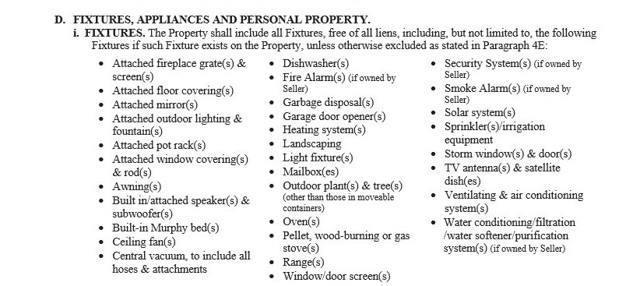

Slide 105
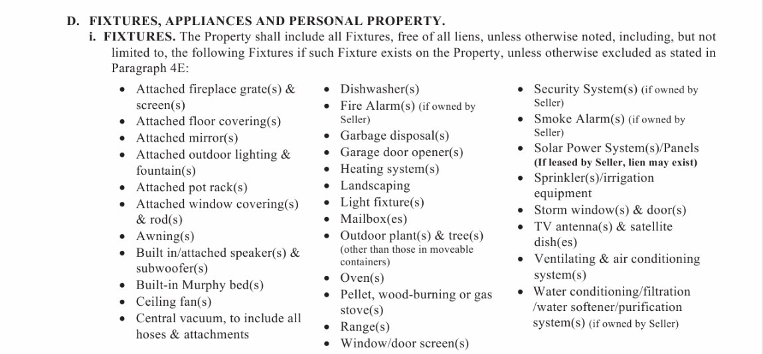

Slide 106
Purchase agreement
Paragraph 4d: Personal Property
The following personal property, if checked, shall remain with the property:
Freestanding ranges

Slide 107
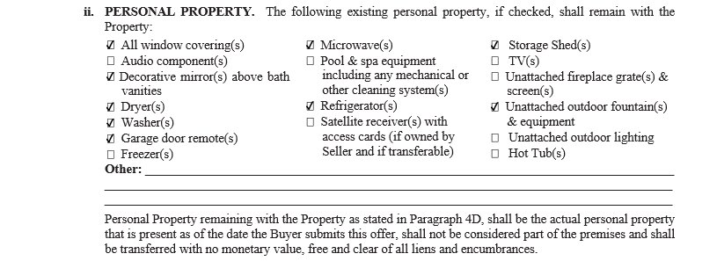

Slide 108
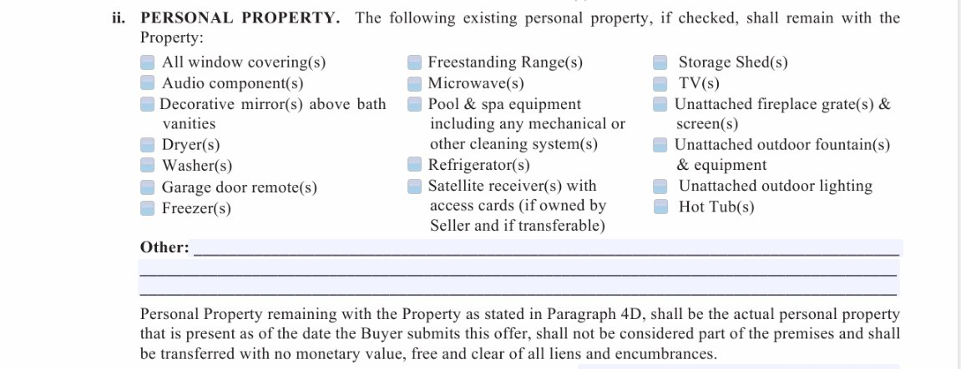

Slide 109
Purchase agreement
Paragraph 5: Financed or Cash Purchase
The first check box has been removed, so this now defaults to 11:59pm the day before closing unless you fill in the blank!

Slide 110
Old version

Slide 111
New version

Slide 112
Purchase agreement
Paragraph 8b: Funding Date
Inserted the phrase “funding date requirements”

Slide 113
Old version

Slide 114
New version

Slide 115
Purchase agreement
Paragraph 9: Possession Date
Check box has been added which gives possession to the buyer once funding date requirements have been met

Slide 116
Old version

Slide 117
New version

Slide 118
Purchase agreement
Paragraph 9B: Possession Date
New language inserted: “or the date the property is surrendered to buyer per a seller occupancy agreement”
and
“In the event seller fails to remove all debris and garbage from the property, seller shall be liable to buyer for all costs associated with removal of such debris and garbage.”

Slide 119
Old version

Slide 120
New version

Slide 121
New version

Slide 122
Purchase agreement
Paragraph 12: Prorations
New language inserted:
“to include any remaining propane gas therein”

Slide 123
Old version

Slide 124
New version

Slide 125
Purchase agreement
Paragraph 17h: Documents
Added to the document grid:
Solar power systems/panels

Slide 126
January 2017 version

Slide 127
July 2017 Version

Slide 128
June 2018 version

Slide 130
Purchase agreement
Paragraph 20I: Resolution
New language inserted:
(collectively “Seller’s Response”). Buyer may not withdraw his objections and terminate this agreement prior to Seller’s Response;

Slide 131
Old version

Slide 132
New version

Slide 133
Purchase agreement
Paragraph 22: Disclaimer
The following language has been removed
And is purchasing Property based solely upon Buyer’s inspection and judgement and not by reason of any representation made to buyer by seller or broker unless expressly set forth in this agreement or disclosure statements.

Slide 134
Old version

Slide 135
New version

Slide 136
Purchase Agreement
Paragraph 40: Buyer and Seller Authorizations
The following Language has been inserted:
the Title Company to deliver any Title Company generated settlement statement(s), in its entirety (Seller and Buyer’s information) to both the Seller and Buyer and their respective Brokers;

Slide 137
Old version

Slide 138
New version

Slide 139
Purchase agreement
AFTER PARAGRAPH 43 AND Above the buyer’s signature
WIRE FRAUD LANGUAGE HAS BEEN ADDED

Slide 140
OLD VERSION

Slide 141
NEW VERSION

Slide 142
Seller’s property disclosure
Ranm 2301

Slide 143
Seller’s property disclosure
Section E7: Mechanical
New language has been added:
SOLAR POWER SYSTEM/PANELS: ___ OWNED ___LEASED.

Slide 144
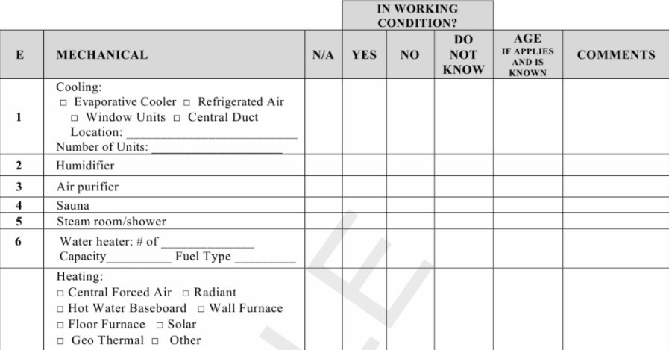

Slide 145
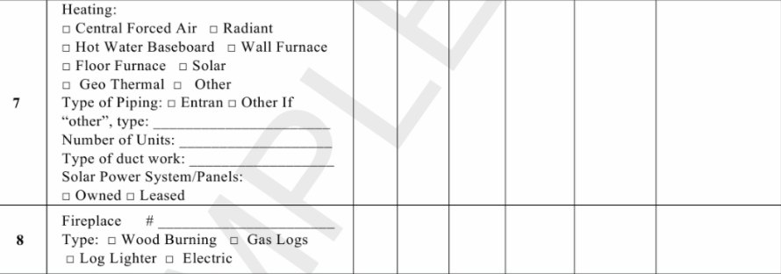

Slide 146
Seller’s property disclosure
Section N4: Insurance Claims
New language has been inserted:
If seller did receive proceeds, did seller use proceeds to repair or correct the issue that was the subject matter of the claim?

Slide 149
Seller’s property disclosure
N9: Lawsuits
New item added to this section:
Lawsuits RE: components of property

Slide 150
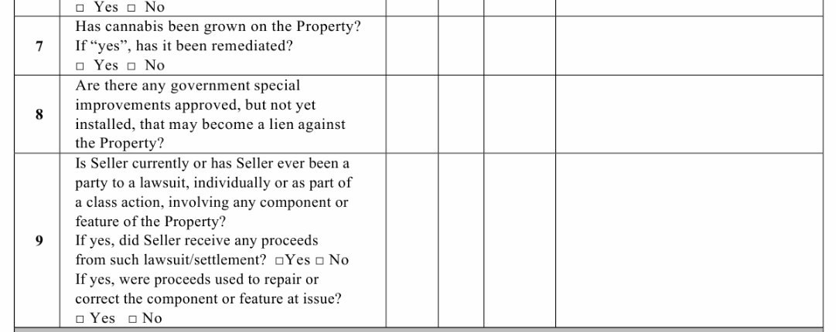

Slide 151
Seller’s property disclosure
Section O:
Entirely new section added:
Prior Inspection Report

Slide 152
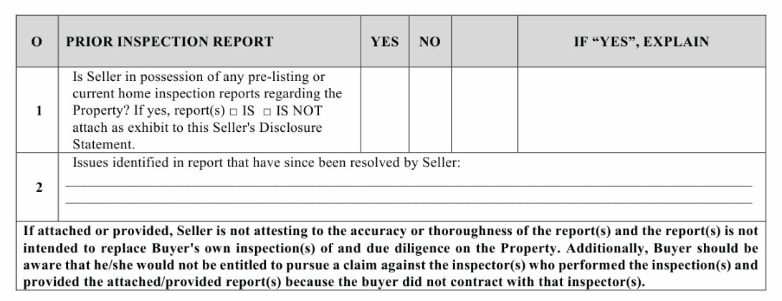

Slide 153
Objections, Resolution and waiver notice
RANM 5109

Slide 154
Objection, resolution and waiver Notice
Objection, Resolution and Waiver Amendment to Purchase Agreement RANM Form 5109
The ORW has been modified to be a stand-alone document; it will no longer be an amendment to the Purchase Agreement. For rational, see RANM Voice Legal Corner. Additionally, the OWR’s intended use will be for buyers and sellers to negotiate repair issues. It should not be used for price reductions or seller credits; the revised OWR has instructions that an amendment to the Purchase Agreement must be used for these purposes. Additionally, the form has been re-formatted.

Slide 155
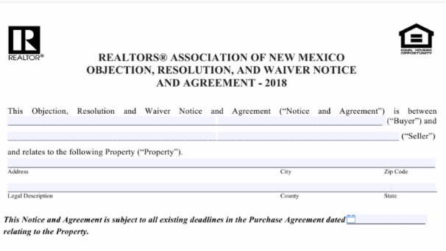

Slide 156
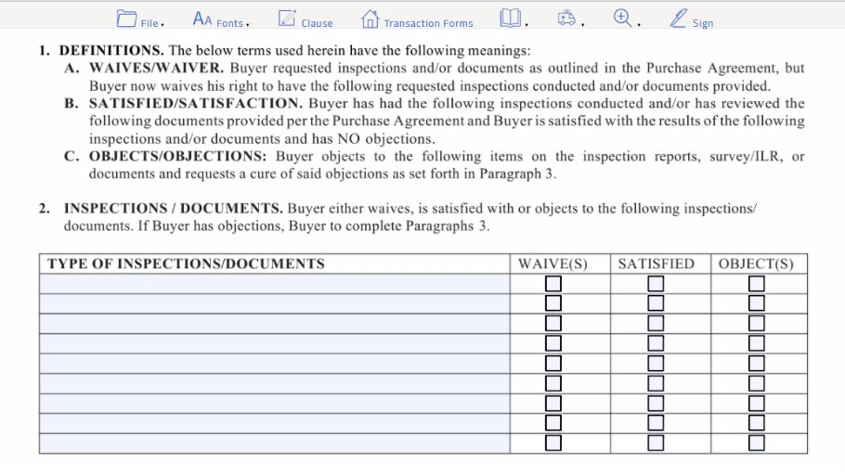

Slide 157
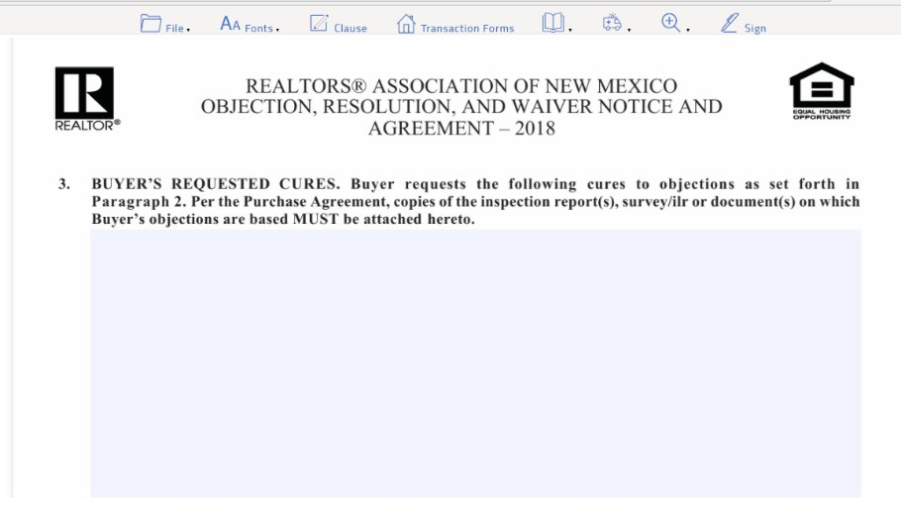

Slide 158
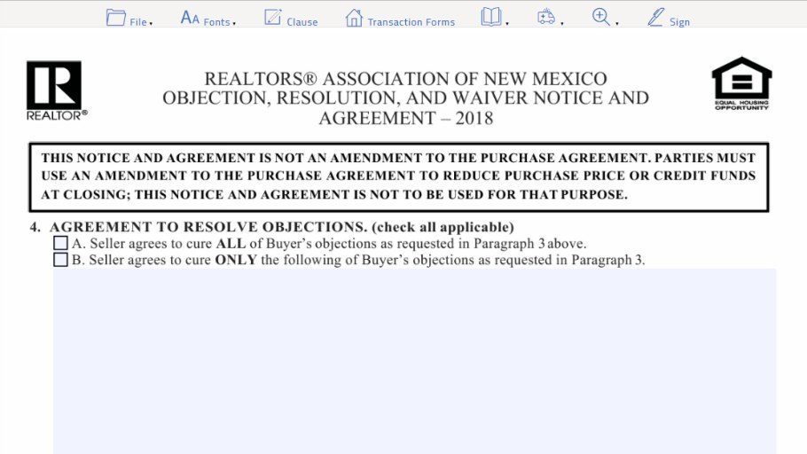

Slide 160
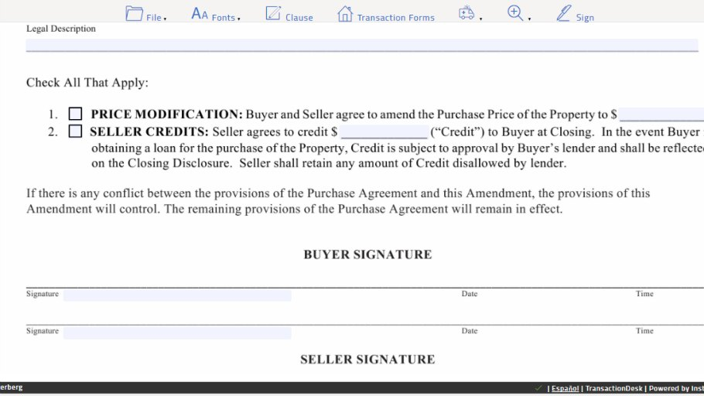

Slide 161
Septic system contingency Addendum
RANM 5120A

Slide 162
Septic system contingency addendum
Paragraph 1 - Reorganized and broken down in subsections A and B
1(A) – Clarifies that an evaluation is not required if a prior evaluation was conducted within 180 days prior to closing (wording on the old form was confusing/ambiguous).
1(B) – Explains that if an evaluation is conducted and property does not close for more than 180 days after evaluation, NMED may require an additional evaluation prior to transfer.
1(B)(i) – Reiterates language from the Purchase Agreement that even if the seller is paying for and/or ordering the septic evaluation, Buyer still gets to choose the evaluator.

Slide 165
Occupancy agreement – seller
RANM 2202

Slide 166
Occupancy Agreement – Seller (Ranm 2202)
Paragraph 4 – Payment. Was reorganized and broken down into 4 subsections.
4(A) – Deposit. Clarifies when Deposit will be refunded if there is no damage to the property.
4(B) – Occupancy Fee. Defines the compensation paid as a “fee” and not “rent.” The term “rent” created issues with the buyer’s lender on the Buyer’s Occupancy Agreement, so it was changed. For consistency, the same terminology was used in the Seller’s Occupancy Agreement.

Slide 167
Occupancy Agreement – Seller (Ranm 2202)
4(C) – New term “Holdover Charge.” In as attempt to clarify the significance and consequences of the Seller remaining in the Property past the agreed upon term.
4(D) Sets forth when deposits, the Occupancy Fees and the Holdover Fees are due.

Slide 168
OLD VERSION

Slide 169
NEW VERSION

Slide 170
Occupancy agreement – Seller (RANM 2202)
Paragraph 6(A)
Added language advising Buyer to check with his/her insurance company regarding coverage after closing, but before seller vacates.

Slide 171
Occupancy agreement – Seller (RANM 2202)

Slide 172
Occupancy agreement – Seller (RANM 2202)

Slide 173
Occupancy agreement – buyer
RANM 2201

Slide 174
Occupancy agreement – buyer (RANM 2201)
Paragraph 3D
Refund of Deposit Language – Moved from Possession/Term Paragraph into Payment Paragraph.

Slide 176
Occupancy agreement – buyer (RANM 2201)
Paragraph 4 – Payment. Reorganized into 4 subsections
4(A) – Deposit. Clarifies when deposit will be refunded if there is no damage to the property.
4(B) – Occupancy Fee. Defines the compensation paid as a “fee” and not as “rent.” The term “rent” created issues with the buyer’s lender, so it was changed herein.
4(C) – New term “Holdover Charge” created in an attempt to clarify the significance and consequences of seller remaining in the Property past the agreed upon term.

Slide 178
Occupancy agreement – buyer (RANM 2201)
Paragraph 5
Clarifies that Buyer shall place utilities in Buyer’s name if it is allowed.

Slide 179
Occupancy agreement – buyer (RANM 2201)

Slide 180
Occupancy agreement – buyer (RANM 2201)
Paragraph 6(B)
Added language advising Seller to check with his/her insurance company when buyer occupies prior to closing.

Slide 182
Seller financing under tila
RANM 2405

Slide 187
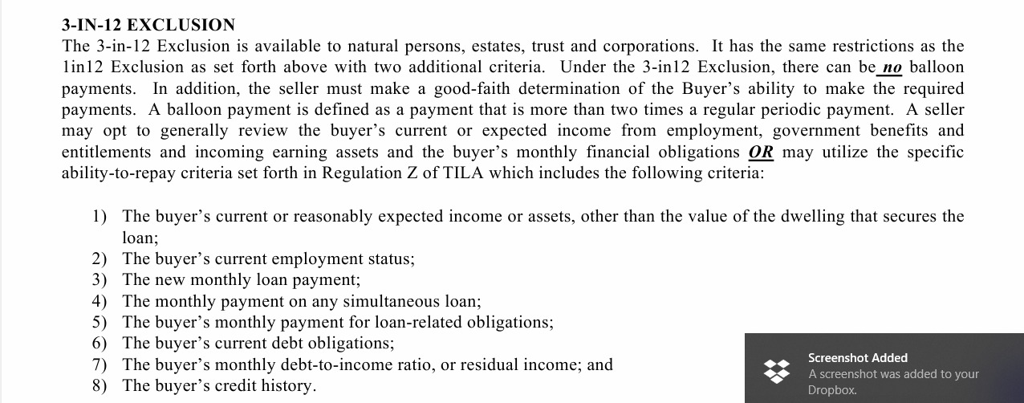

Slide 188
Restrictions on Seller Financing
1 in 12 Exclusion
3 in 12 Exclusion
They are a natural person, estate or trust;
They provide financing for only one property in a 12 month period;
They own the property securing the financing
They did not construct or act as the contractor for the construction of a residence on the property
They are a natural person, estate or trust, or an entity
They provide financing for 3 properties or less in a 12 month period;
They own the property securing the financing
They did not construct or act as the contractor for the construction of a residence on the property

Slide 189
Restrictions on Seller Financing
1 in 12 Exclusion
3 in 12 Exclusion
The financing must have a repayment schedule which does not result in a negative amortization;
Balloon payments are allowed (not less than 5 years, however you can do 2 years;
The financing must be fully amortizing and the must be no balloon payments or structures allowed;

Slide 190
Restrictions on Seller Financing
1 in 12 Exclusion
3 in 12 Exclusion
The financing must have a fixed rate or an adjustable rate that only resets after five or more years and must have caps;
The seller does not have to vet the borrowers or determine the borrower’s ability to repay.
The financing must have a fixed rate or an adjustable rate that only resets after five or more years and must have caps;
The seller must determine if the consumer has a reasonable ability to repay

