Slide 2
Handling multiple offers ethically and effectively
4CE Credit
Ethics Elective (satisfies your licensing requirement)

Slide 3
The ground rules
Cell phones on vibrate please!
If you absolutely need to take a call, please step outside
Two short breaks

Slide 4
The ground rules
The success of this class depends on YOU! You will be expected to participate!
This is your class, ask questions! I may answer them now, or I may answer them later, but I will do my best to answer them!

Slide 5
Course Objectives
Identify and discuss the articles in the NAR Code of Ethics that are especially relevant to multiple offer situations
Identify and discuss the Broker Duties that are especially relevant to multiple offer situations
Apply the principles in the COE and Broker Duties to multiple offer situations to insure licensees are practicing in a professional and ethical manner

Slide 6
Course Objectives
Learn about the proper Use of RANM forms in multiple offer situations to demonstrate broker competency
Identify best practices concerning communication with all parties involved in multiple offer situations to insure fairness
Learn how to help your buyer clients/customers win in multiple offer situations

Slide 7
Course Objectives
Learn about and discuss the pros and cons of escalation clauses
Learn about and discuss the pros and cons of multiple offer ‘love letters’

Slide 8
Roadmap for today’s class
Three sections
Ethical considerations – Code of Ethics, Broker Duties
Practical considerations – Paperwork, procedures and communication
Effectiveness – How to Win at Multiple Offers

Slide 9
Your navigator
Licensed Realtor since 2004
Focusing on residential sales in the Albuquerque metro
Over 280 Purchase Contracts Written and Closed
QB license, not a designated broker

Slide 10
Your navigator
No lawsuits. No mediations. No ethics violations
2012 Compliance Committee chair
2016-2018 GAAR Board of Directors
Instructor for the 2017 and 2018 Core Class

Slide 11
Introduce yourselves
Name
Brokerage
Years licensed
Specialty area (if any)
Something about you that few people know

Slide 12
Handling multiple offers ethically and effectively
4CE Credit
Ethics Elective (satisfies your licensing requirement)

Slide 13
It’s a seller’s market!!!

Slide 14
What is a sellers market?
A seller’s market occurs when demand exceeds supply, or there are more buyers seeking to purchase properties than there are available homes on the market.

Slide 15
What is a sellers market?
This often leads to multiple buyers interested in a single property, resulting in bidding wars. A seller’s market is a fantastic time to sell your home as you could secure a sale price that’s higher than your listing price, or at least more than your bottom line (the lowest price you’d be willing to accept for your home).
From Redfin: https://www.redfin.com/resources/buyers-market-sellers-market

Slide 16
Absorption rate
Absorption rate is a real estate stat that can be used to understand current market conditions. Measured in months, the absorption rate is one of the most current and accurate assessments of what the real market conditions are.

Slide 17
Absorption rate
Based on the relationship between total homes for sale and total homes sold, it does a better job of measuring the market because it demonstrates the all important balance between those two important numbers.

Slide 18
Absorption rate
It's not difficult to calculate what the absorption rate is. It's a very simple equation. Homes for sale/homes sold.

Slide 19
Absorption rate
Homes for sale / homes that sold last month = months of inventory

Slide 20
Absorption rate
3000 homes for sale / 1000 homes sold = 3 months of inventory

Slide 23
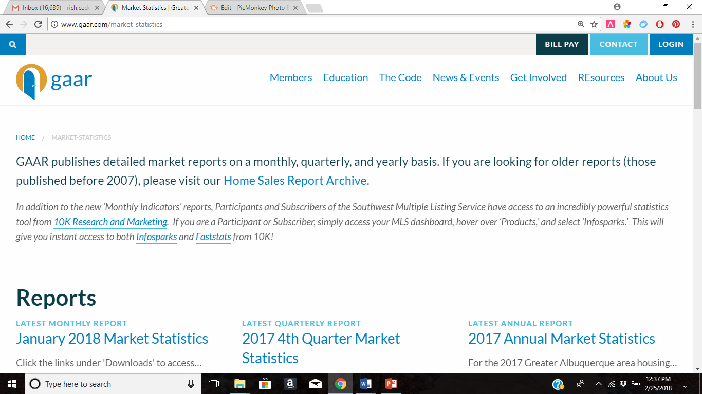

Slide 24
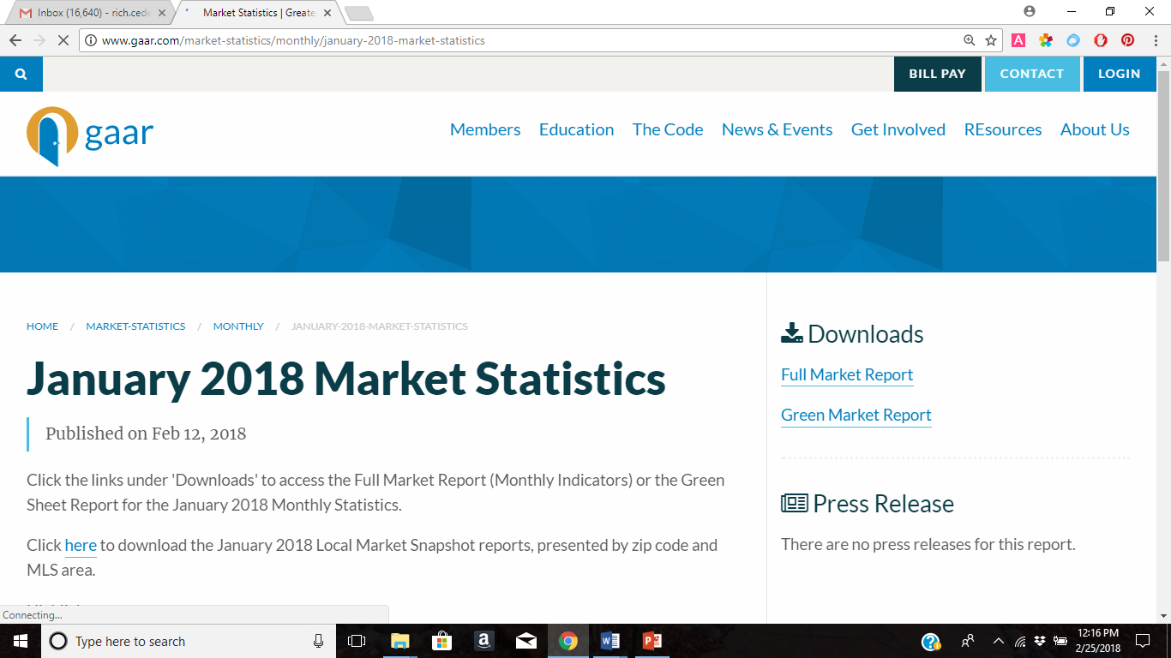

Slide 25
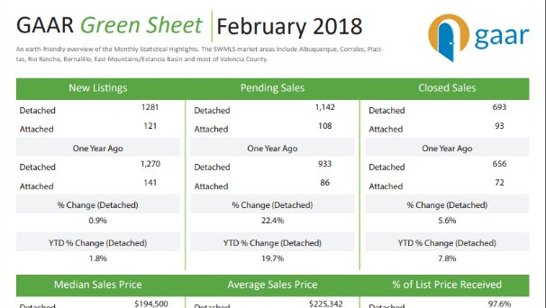

Slide 28
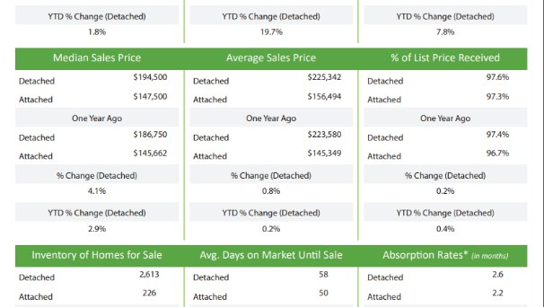

Slide 29
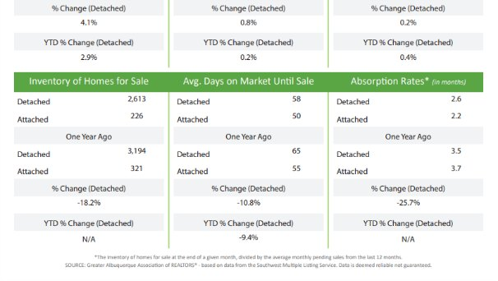

Slide 33
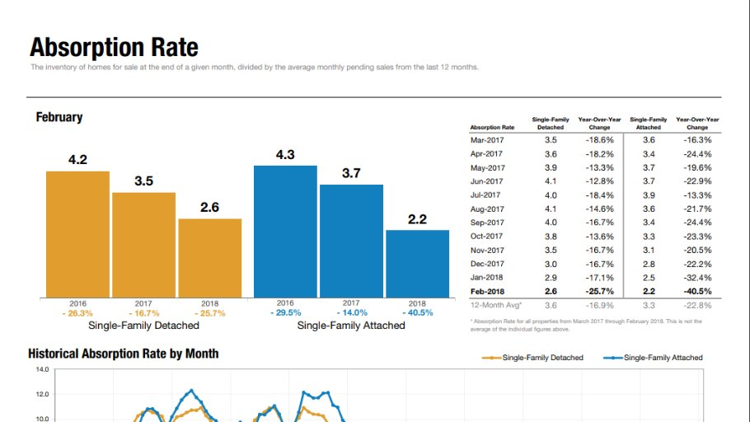

Slide 35
Problems caused by a fast moving market
The market is hot, offers are flying, things get rushed
Can lead to listing broker sloppiness
Sloppiness with communication, procedures and paperwork
Leaving consumers (buyers) feeling like there are no rules and this is “worse than buying a car”
Buyer brokers being left in the dark/feeling they’ve been treated unethically or unfairly
Increased listing broker liability

Slide 36
NAR’s code of ethics and multiple offers

Slide 37
NAR Code of ethics
17 articles to guide us, including an meaningful introduction/preamble
3 sections
Duties to Clients and Customers
Duties to the Public
Duties to Realtors
Clear guidelines for “professional and ethical conduct”

Slide 38
Nar code of ethics
“Perhaps no situation routinely faced by Realtors® can be more frustrating, fraught with potential for misunderstanding and missed opportunity, and elusive of a formulaic solution than presenting and negotiating multiple purchase or lease offers and/or counter-offers on the same property. Consider the competing dynamics, listing brokers are charged with helping sellers get the highest price and the most favorable terms for their property.

Slide 39
Nar code of ethics
Buyer’s brokers help their clients purchase property at the lowest price and on favorable terms. Balanced against the Code’s mandate of honesty is the imperative to refrain from making disclosures that may not, in the final analysis, be in a client’s interests.”
From appendix IX to Part Four Code of Ethics Arbitration Manual

Slide 40
Nar code of ethics
Realize that in multiple offer situations only one offer will result in a sale and one (or more) potential purchasers will be disappointed that their offer was not accepted. While little can be done to assuage their disappointment, fair and honest treatment throughout the process; coupled with prompt, ongoing and open communication, will enhance the likelihood they will feel they were treated fairly and honestly,
From appendix IX to Part Four Code of Ethics Arbitration Manual

Slide 41
Nar code of ethics
In this regard, “… Realtors® can take no safer guide than that which has been handed down through the centuries, embodied in the Golden Rule, “whatsoever ye would that others should do to you, do ye even so to them.’”
From the preamble to the Code of Ethics

Slide 42
Nar code of ethics
“While the Code of Ethics does not expressly mandate “fairness” (given its inherent subjectivity), remember that the Preamble has long noted that “. . . REALTOR® has come to connote competency, fairness, and high integrity. . . .” If a seller directs you to advise offerors about the existence of other purchase offers, fairness dictates that all offerors or their representatives be so informed.”

Slide 43
Article one
“When representing a buyer, seller, landlord, tenant, or other client as an agent, REALTORS® pledge themselves to protect and promote the interests of their client. This obligation to the client is primary, but it does not relieve REALTORS® of their obligation to treat all parties honestly. When serving a buyer, seller, landlord, tenant or other party in a non-agency capacity, REALTORS® remain obligated to treat all parties honestly. ”

Slide 44
Article one
“When representing a buyer, seller, landlord, tenant, or other client as an agent, REALTORS® pledge themselves to protect and promote the interests of their client. This obligation to the client is primary, but it does not relieve REALTORS® of their obligation to treat all parties honestly. When serving a buyer, seller, landlord, tenant or other party in a non-agency capacity, REALTORS® remain obligated to treat all parties honestly. ”

Slide 45
Article one
“When representing a buyer, seller, landlord, tenant, or other client as an agent, REALTORS® pledge themselves to protect and promote the interests of their client. This obligation to the client is primary, but it does not relieve REALTORS® of their obligation to treat all parties honestly. When serving a buyer, seller, landlord, tenant or other party in a non-agency capacity, REALTORS® remain obligated to treat all parties honestly. ”

Slide 46
Article one
“When representing a buyer, seller, landlord, tenant, or other client as an agent, REALTORS® pledge themselves to protect and promote the interests of their client. This obligation to the client is primary, but it does not relieve REALTORS® of their obligation to treat all parties honestly. When serving a buyer, seller, landlord, tenant or other party in a non-agency capacity, REALTORS® remain obligated to treat all parties honestly. ”

Slide 47
Article one
“When representing a buyer, seller, landlord, tenant, or other client as an agent, REALTORS® pledge themselves to protect and promote the interests of their client. This obligation to the client is primary, but it does not relieve REALTORS® of their obligation to treat all parties honestly. When serving a buyer, seller, landlord, tenant or other party in a non-agency capacity, REALTORS® remain obligated to treat all parties honestly. ”

Slide 48
Article one
Standard of Practice 1-6
REALTORS® shall submit offers and counter-offers objectively and as quickly as possible.

Slide 49
Article one
Standard of Practice 1-7
When acting as listing brokers, REALTORS® shall continue to submit to the seller/landlord all offers and counter-offers…unless the seller has waived this obligation in writing. REALTORS® shall not be obligated to continue to market the property after an offer has been accepted by the seller/landlord.

Slide 50
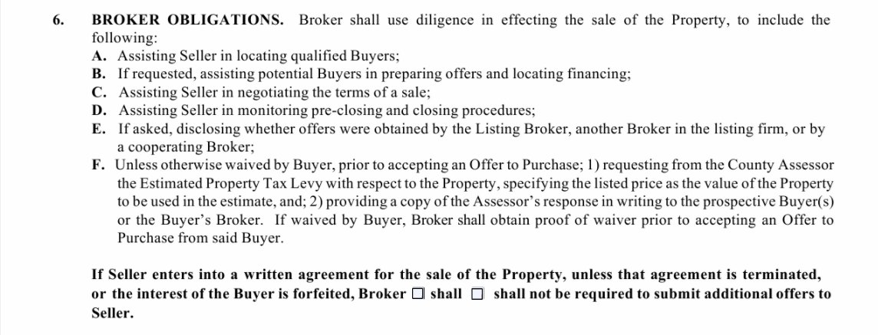

Slide 51
Article one
Standard of Practice 1-13
the possibility that sellers or seller’s representatives may not treat the existence, terms, or conditions of offers as confidential unless confidentiality is required by law, regulation, or by any confidentiality agreement between the parties.

Slide 52
Article one
Standard of Practice 1-15
REALTORS®, in response to inquiries from buyers or cooperating brokers shall, with the sellers’ approval, disclose the existence of offers on the property. Where disclosure is authorized, REALTORS® shall also disclose, if asked, whether offers were obtained by the listing licensee, another licensee in the listing firm, or by a cooperating broker.

Slide 53
Article two
REALTORS® shall avoid exaggeration, misrepresentation, or concealment of pertinent facts relating to the property or the transaction. REALTORS® shall not, however, be obligated to discover latent defects in the property, to advise on matters outside the scope of their real estate license, or to disclose facts which are confidential under the scope of agency or non-agency relationships as defined by state law.

Slide 54
What do our broker duties say about confidentiality?

Slide 55
What does Broker Duties say about confidentiality?
5. Maintenance of any confidential information learned in the course of any prior agency relationship unless the disclosure is with the former principal’s written consent or is required by law;

Slide 56
Broker duties and confidentiality
7. Unless otherwise authorized in writing, a broker who is directly providing real estate services to a seller shall not disclose the following to the buyer in a transaction:
A. that the seller has previously indicated he/she will accept a sales price less than the asking or listed price;
B. that the seller will agree to financing terms other than those offered;
C. the seller motivations for selling/leasing; or
D. any other information the seller has requested in writing remain confidential, unless disclosure is required by law;

Slide 57
Broker duties and confidentiality
8. Unless otherwise authorized in writing, a broker who is directly providing real estate service to a buyer shall not disclose the following to the seller in the transaction:
A. that the buyer has previously indicated he/she will pay a price greater than the price submitted in a written offer;
B. the buyer’s motivation for buying; or
C. any other information the buyer has requested in writing remain confidential, unless disclosure is required by law.

Slide 58
Back to the code of ethics!

Slide 59
Article three
REALTORS® shall cooperate with other brokers except when cooperation is not in the client’s best interest. The obligation to cooperate does not include the obligation to share commissions, fees, or to otherwise compensate another broker.

Slide 60
Article three
Standard of Practice 3-2
Any change in compensation offered for cooperative services must be communicated to the other REALTOR® prior to the time that REALTOR® submits an offer to purchase/lease the property. After a REALTOR® has submitted an offer to purchase or lease property, the listing broker may not attempt to unilaterally modify the offered compensation with respect to that cooperative transaction.

Slide 61
Article three
Standard of Practice 3-3
Standard of Practice 3-2 does not preclude the listing broker and cooperating broker from entering into an agreement to change cooperative compensation.

Slide 62
Article three
Standard of Practice 3-4
REALTORS®, acting as listing brokers, have an affirmative obligation to disclose the existence of dual or variable rate commission arrangements

Slide 63
Article three
The listing broker shall, as soon as practical, disclose the existence of such arrangements to potential cooperating brokers and shall, in response to inquiries from cooperating brokers, disclose the differential that would result in a cooperative transaction or in a sale/lease that results through the efforts of the seller/landlord.
If the cooperating broker is a buyer representative, the buyer representative must disclose such information to their client before the client makes an offer to purchase or lease.

Slide 64
Article three
Standard of Practice 3-6
REALTORS® shall disclose the existence of accepted offers, including offers with unresolved contingencies, to any broker seeking cooperation.

Slide 65
Listing agreement
Brokers to divulge ___ terms ___ existence of offers on the Property in response to inquiries from buyers or cooperating brokers.

Slide 66
Article three
Article 3 calls on REALTORS® to “. . . cooperate with other brokers except when cooperation is not in the client’s best interest.” Implicit in cooperation is forthright sharing of information related to cooperative transactions and potential cooperative transactions. Much of the frustration that occurs in multiple offer situations results from cooperating brokers being unaware of the status of offers they have procured.

Slide 67
Article three
Listing brokers should make reasonable efforts to keep cooperating brokers informed. Similarly, buyer brokers should make reasonable efforts to keep listing brokers informed about the status of counter-offers their seller-clients have made.”
From appendix IX to Part Four Code of Ethics Arbitration Manual

Slide 68
Article seven
In a transaction, REALTORS® shall not accept compensation from more than one party, even if permitted by law, without disclosure to all parties and the informed consent of the REALTOR®’s client or clients.

Slide 69
Article nine
REALTORS®, for the protection of all parties, shall assure whenever possible that all agreements related to real estate transactions including, but not limited to, listing and representation agreements, purchase contracts, and leases are in writing in clear and understandable language expressing the specific terms, conditions, obligations and commitments of the parties. A copy of each agreement shall be furnished to each party to such agreements upon their signing or initialing.

Slide 70
Article nine
Standard of Practice 9-1
For the protection of all parties, REALTORS® shall use reasonable care to ensure that documents pertaining to the purchase, sale, or lease of real estate are kept current through the use of written extensions or amendments.

Slide 71
Article ten
REALTORS® shall not deny equal professional services to any person for reasons of race, color, religion, sex, handicap, familial status, national origin, sexual orientation, or gender identity. REALTORS® shall not be parties to any plan or agreement to discriminate against a person or persons on the basis of race, color, religion, sex, handicap, familial status, national origin, sexual orientation, or gender identity.

Slide 72
Article ten
Standard of Practice 10-1
When involved in the sale or lease of a residence, REALTORS® shall not volunteer information regarding the racial, religious or ethnic composition of any neighborhood nor shall they engage in any activity which may result in panic selling, however, REALTORS® may provide other demographic information.

Slide 73
Article fifteen
REALTORS® shall not knowingly or recklessly make false or misleading statements about other real estate professionals, their businesses, or their business practices.

Slide 74
Article sixteen
REALTORS® shall not engage in any practice or take any action inconsistent with exclusive representation or exclusive brokerage relationship agreements that other REALTORS® have with clients.

Slide 75
Broker duties and multiple offers

Slide 76
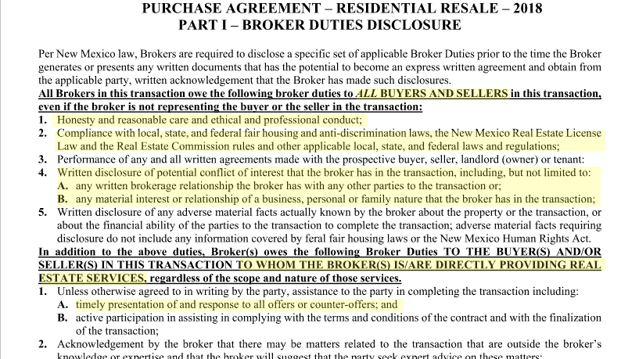

Slide 77
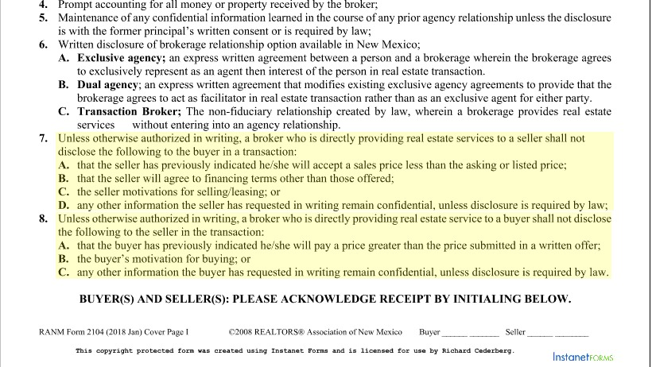

Slide 78
Broker to broker obligations

Slide 79
Broker Obligations to other Brokers
Brokers owe the following professional obligations to other brokers:

Slide 80
Broker to Broker Obligations
1. Honesty, reasonable care, and ethical and professional conduct;
2. Timely presentation of offers and counter-offers and responses thereto, unless otherwise agreed to in writing…
3. Active participation in assisting the party to whom the broker is directly providing real estate services in complying with the terms and conditions of the contract and with the closing of the transaction…

Slide 81
Broker to broker obligations
4. Compliance with local, state, and federal fair housing and anti-discrimination laws, the New Mexico real estate license law and the real estate commission rules; the New Mexico uniform owner-resident relations act, and other applicable local, state, and federal laws and regulations.

Slide 82
Broker to broker obligations
5. Written disclosure of any adverse material facts actually known by the broker about the property or the transaction, or about the financial ability of the parties to the transaction to complete the transaction; adverse material facts requiring disclosure do not include any information covered by federal fair housing laws or the New Mexico human rights act.

Slide 83
Broker to broker obligations
6. Written disclosure of any potential conflict of interest that the broker has in the transaction, including but not limited to any material interest the broker has in the transaction or any relationship of a business, personal or family nature that the broker has with a party to the transaction
7. Non-interference with a purchase agreement or any express written agreement that another broker has with a buyer, seller, landlord (owner) or tenant.

Slide 84
Applying the code of ethics and broker duties - three scenarios

Slide 85
Scenario one

Slide 86
Scenario one
Listing broker Benny receives an offer from buyer #1 on Tuesday at 3pm which expires the following day at 3pm. At 1pm on Wednesday, the broker for buyer #2 contacts Benny and asks if there are any offers. Benny tells buyer #2 that indeed there is another offer, but that he’ll stall on presenting buyer #1’s offer until 6pm, allowing buyer #2 enough time to submit their offer. Benny calls buyer broker #1 and tells him he can’t present the offer until 6pm when his client gets home from work.

Slide 87
Scenario one
Buyer #2, knowing that the seller has another offer decides to offer list price on the property, which the seller promptly accepts without any kind of counter offer.

Slide 88
Scenario one
Did the listing broker do anything wrong?

Slide 89
Scenario one
He should have notified buyer #1 about the presence of a second offer. In fact, Benny might have been able to net his seller more money if he advised the seller to notify buyer #1 that there was now a second offer on the property.
Benny says he would have done that except he didn’t have buyer #2’s offer until it was too late, and he didn’t want to scare buyer #1 away with the prospect of multiple offers.

Slide 90
Scenario one
Did listing broker Benny violate the Code of Ethics? The Broker Duties?
Article One - treat all parties honestly
Standard of practice 1-6, REALTORS® shall submit offers and counter-offers objectively and as quickly as possible (should have done an invitation to offer).

Slide 91
Scenario one
Article Two – concealment of pertinent facts – did not tell buyer broker #1 about the presence of the second offer.

Slide 92
Scenario two

Slide 93
Scenario two
Realtor Amy had a wonderful listing in the North Valley. She had it on the market for over 90 days.
Realtor Bob called on Saturday afternoon to let her know he was going to show it. Realtor Amy said that was fine because it was vacant.
Realtor Cal had shown it on Friday and never returned Realtor Amy’s call for showing feedback.

Slide 94
Scenario two
Sunday morning, April 6th, 2014 at 10:30am, Realtor Bob called Realtor Amy and told her he was writing an offer and would get it to her by 1pm.

Slide 95
Scenario two
Around 11am, Realtor Cal had faxed over an over of $3,500 below the list price, with the buyer asking for $1,500 in closing cost assistance. Their deadline was 7pm that same evening. Realtor Amy presented the offer to the seller at 3pm. As of 5pm no offer had been received from Realtor Bob.

Slide 96
Scenario two
#1 Should Realtor Amy tell the seller that another offer was in the works?
#2 Should Realtor Amy call the other agent to let them know she had another offer?
#3 Not wanting to lose the offer, should the seller accept the offer and be done with it?

Slide 97
Scenario two
Realtor Amy thinks the offer presented by Realtor Cal is perfect and does not tell the Seller that there may be another offer coming. The Seller accepts the offer at 5:30pm. At 6:30pm Realtor Amy receives a full price offer from Realtor Bob via email. Realtor Amy sends Realtor Bob a quick email saying “thanks, but my seller already accepted an offer today.”

Slide 98
Scenario two
Realtor Bob can’t believe the Realtor Amy did not inform the Seller that his Buyer planned on submitting an offer and that she did not try to get the seller the best possible price. Realtor Bob files and ethics complaint on April 17th, 2014 against Realtor Amy, saying she violated Article 1 because she knew that he had a interested Buyer and should have given his Buyer a chance to submit an offer.

Slide 99
Scenario three
Multiple Offers to be Presented Objectively
REALTOR® Alex listed Seller Sam's house. He filed the listing with the MLS and conducted advertising intended to interest prospective purchasers. Seller Sam's house was priced reasonably and attracted the attention of several potential purchasers.

Slide 100
Scenario three
Buyer Betty learned about Seller Sam's property from REALTOR® Alex's website, called REALTOR® Alex for information, and was shown the property by REALTOR® Alex several times. Buyer Xavier, looking for property in the area, engaged the services of REALTOR® Renee as a buyer representative. Seller Sam's property was one of several REALTOR® R introduced to Buyer Xavier.

Slide 101
Scenario three
After the third showing, Buyer Betty was ready to make an offer and requested REALTOR® Alex's assistance in writing a purchase offer. REALTOR® Alex helped Buyer Betty prepare an offer and then called Seller Sam to make an appointment to present the offer that evening.

Slide 102
Scenario three
Later that same afternoon, REALTOR® Renee called REALTOR® Alex and told him that she was bringing a purchase offer to REALTOR® Alex's office for REALTOR® Alex to present to Seller Sam. REALTOR® Alex responded that he would present Buyer Xavier's offer that evening.

Slide 103
Scenario three
That evening, REALTOR® Alex presented both offers to Seller Sam for his consideration. Seller Sam noted that both offers were for the full price and there seemed to be little difference between them.

Slide 104
Scenario three
REALTOR® Alex responded, "I'm not telling you what to do, but you might consider that I have carefully pre-qualified Buyer Betty. There's no question but that she'll get the mortgage she'll need to buy your house. Frankly, I don't know what, if anything, REALTOR® Renee has done to pre-qualify her client. I hope he'll be able to get a mortgage, but you never can tell."

Slide 105
Scenario three
REALTOR® Alex added, "Things can get complicated when a buyer representative gets involved. They make all sorts of demands for their clients and closings can be delayed. You don't want that, do you? Things are almost always simpler when I sell my own listings," he concluded.

Slide 106
Scenario three
Seller Sam, agreeing with REALTOR® Alex's reasoning, accepted Buyer Betty's offer and the transaction closed shortly thereafter.

Slide 107
Scenario three
Upset that his purchase offer hadn't been accepted, Buyer Xavier called Seller Sam directly and asked, "Just to satisfy my curiosity, why didn't you accept my full price offer to buy your house?" Seller Sam explained that he had accepted another full price offer, had been concerned about Buyer Xavier being able to obtain the necessary financing, and had been concerned about delays in closing if a buyer representative were involved in the transaction.

Slide 108
Scenario three
Buyer Xavier shared Seller Sam's comments with REALTOR® R the next day. REALTOR® Renee, in turn, filed an ethics complaint alleging that REALTOR® Alex's comments had intentionally cast Buyer Xavier's offer in an unflattering light, that his comments about buyer representatives hindering the closing process had been inaccurate and unfounded, and that REALTOR® Alex's presentation of the offer had been subjective and biased and in violation of Article 1 as interpreted by Standard of Practice 1-6.

Slide 109
Scenario three
At the hearing, REALTOR® Alex tried to justify his comments, noting that although he had no personal knowledge of Buyer Xavier's financial wherewithal and while he hadn't had a bad experience dealing with represented buyers, it was conceivable that an overzealous buyer representative could raise obstacles that might delay a closing.

Slide 110
Scenario three
In response to REALTOR® Renee's questions, REALTOR® Alex acknowledged that his comments to Seller Sam about Buyer Xavier's ability to obtain financing and the delays that might ensue if a buyer representative were involved were essentially speculation and not based on fact.

Slide 111
Scenario three
Answer: The Hearing Panel concluded that REALTOR® Alex's comments and overall presentation had not been objective as required by Standard of Practice 1-6 and found REALTOR® Alex in violation of Article 1.

Slide 112
Buyer’s and seller’s Guide to multiple offer Negotiations
Copyright 2005 National Association of REALTORS®

Slide 113
NAR Guide to Multiple Offer Negotiations
Information for Buyers
“In some situations sellers will have several competing purchase offers to consider. Sellers have several ways to deal with multiple offers. “

Slide 114
NAR Guide to Multiple Offer Negotiations
“Sellers can accept the “best” offer
They can inform all potential purchasers that other offers are “on the table [and that they should bring their highest and best]; “
They can “counter” one offer while putting the other offers to the side awaiting a decision on the counter-offer; or
They can “counter” one offer and reject the others.”

Slide 115
NAR Guide to Multiple Offer Negotiations
“While the listing broker can offer suggestions and advice, decisions about how offers will be presented – and dealt with – are made by the seller - not by the listing broker”

Slide 116
NAR Guide to Multiple Offer Negotiations
Purchase offers generally aren’t confidential. In some cases sellers may make other buyers aware that your offer is in hand, or even disclose details about your offer to another buyer in hope of convincing that buyer to make a “better” offer. In some cases sellers will instruct their listing broker to disclose an offer to other buyers on their behalf.

Slide 117
NAR Guide to Multiple Offer Negotiations
“Listing brokers are required to follow lawful, ethical instructions from their clients in the same way that buyer-representatives must follow lawful, ethical instructions from their buyer-clients. While some REALTORS® may be reluctant to disclose terms of offers, even at the direction of their seller-clients, the Code of Ethics does not prohibit such disclosure. In some cases state law or real estate regulations may limit the ability of brokers to disclose the existence or terms of offers to third parties.”

Slide 118
NAR Guide to Multiple Offer Negotiations
Information for Sellers
It’s possible you may be faced with multiple competing offers to purchase your property. Your listing broker can explain various negotiating strategies for you to consider.

Slide 119
NAR Guide to Multiple Offer Negotiations
You can accept the “best” offer;
You can inform all potential purchasers that other offers are “on the table” and invite them to make their “best” offer;
You can “counter” one offer while putting the other offers to the side awaiting a decision on your counter-offer;
You can “counter” one offer and reject the others.”

Slide 120
NAR Guide to Multiple Offer Negotiations
“Realize that each of these approaches has advantages and disadvantages. Patience may result in an even better offer being received; inviting buyers to make their “best” offers may produce an offer (or offers) better than those “on the table” – or may discourage buyers who feel they’ve already made a fair offer resulting in them breaking off negotiations to pursue other properties. Your listing broker will explain the pros and cons of these strategies (and possibly other) negotiating strategies. The decisions, however, are yours to make.”

Slide 121
NAR Guide to Multiple Offer Negotiations
Information for Buyer and Sellers
“What’s fair? What’s honest? Why isn’t there a single, simple way to deal with multiple competing offers?
The Code of Ethics obligates REALTORS® to be honest with all parties; to present offers and counter-offers quickly and objectively; and to cooperate with other brokers. Cooperation involves sharing of relevant information.”

Slide 122
NAR Guide to Multiple Offer Negotiations
“Frequently frustration and misunderstanding results from cooperating brokers being unaware of the status of offers they have presented on behalf of their buyer-clients. Listing brokers should make reasonable efforts to keep buyer-representatives up-to-date on the status of offers. Similarly, buyer-representatives should keep listing brokers informed about the status of counter-offers their seller-clients have made.”

Slide 123
NAR Guide to Multiple Offer Negotiations
“Finally, buyers and sellers need to appreciate that in multiple offer situations only one offer will result in a sale, and the other buyers will often be disappointed their offers were not accepted. While little can be done to assuage that disappointment, fair and honest treatment throughout the offer and negotiation process, coupled with prompt, ongoing and open communication, can enhance the chances that all buyers – successful or not – will feel they were treated fairly and honestly.”

Slide 124
Ranm forms and multiple offers

Slide 125
Ranm invitation to offer
Notifies the buyer that the seller is inviting offers from more than one buyer.
Notifies the buyer that invitations to offer may not be identical
Does not constitute an offer to sell on the terms, it’s just an invitation.
Notifies buyer that seller has a right to accept any one, or none, of the offers.

Slide 126
Ranm invitation to offer
Notifies the buyer that even if buyer’s offer is received first it does not bind the seller in any way, seller can still choose from among offers received.
Buyer must respond by the deadline.
If buyer signs agreeing to seller terms it’s still not a deal until seller acknowledges it by signing.

Slide 127
Ranm invitation to offer
If buyer doesn’t like the terms on the ITO, they shouldn’t counter or amend, they should re write their offer.
If the buyer responds by signing the ITO, seller has a deadline to respond.
Once seller signs, we have a contract!

Slide 128
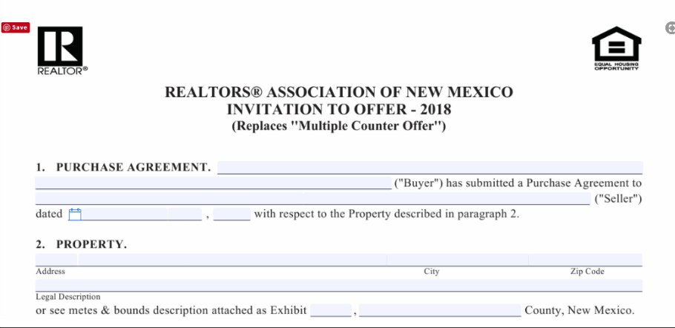

Slide 129
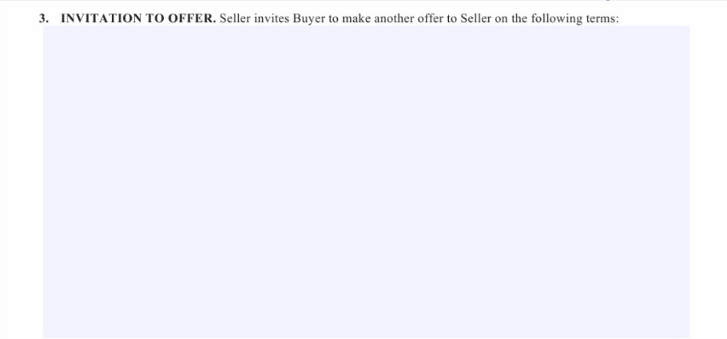

Slide 131
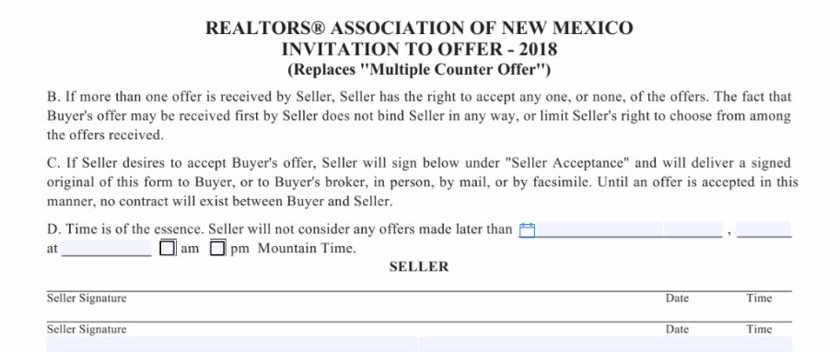

Slide 132
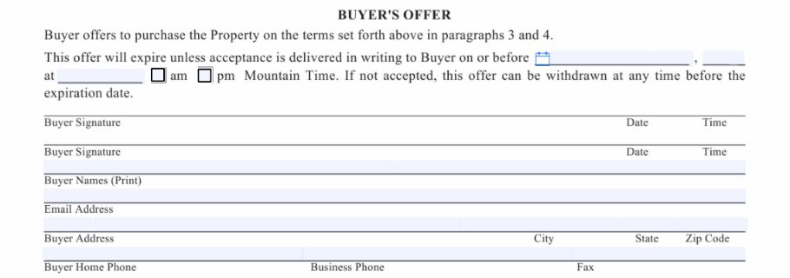

Slide 134
Buyer’s response to invitation to offer
If buyer doesn’t agree to terms of the invitation to offer, how should the buyer respond?
Amend the Invitation?
Counter the Invitation?
Rewrite the Purchase Agreement?

Slide 135
Discussion: Ranm invitation to offer
Does the seller have to use this form?
Should the seller consider countering one offer only?
Should the seller always use this form when they call for highest and best?
Why not just do a verbal highest and best?

Slide 136
Discussion: Ranm invitation to offer
When is using the Invitation to Offer to the seller’s advantage?
Can improper handling of multiple offers lead to the appearance of impropriety concerning Fair Housing laws?

Slide 137
Communicating Effectively and Fairly

Slide 138
Effective Communication
“Realize that in multiple offer situations only one offer will result in a sale and one (or more) potential purchasers will be disappointed that their offer was not accepted. While little can be done to assuage their disappointment, fair and honest treatment throughout the process; coupled with prompt, ongoing and open communication, will enhance the likelihood they will feel they were treated fairly and honestly. ”

Slide 139
Nar code of ethics
“While the Code of Ethics does not expressly mandate “fairness” (given its inherent subjectivity), remember that the Preamble has long noted that “. . . REALTOR® has come to connote competency, fairness, and high integrity. . . .” If a seller directs you to advise offerors about the existence of other purchase offers, fairness dictates that all offerors or their representatives be so informed.”

Slide 140
effective communication
REALTORS® can take no safer guide than that which has been handed down through the centuries, embodied in the Golden Rule, ‘Whatsoever ye would that others should do to you, do ye even so to them.’ ” (from the Preamble to the Code of Ethics).

Slide 141
effective communication
What’s the best way to respond to inquiries like
“Do you have any offers?”
“Is the property still available?”

Slide 142
effective communication
What’s the best way to notify all parties of the presence of other offers? Text? Email? Phone?
Can you dictate the method of communication? Text all interested parties? Email? Please do not call LA?
How about the MLS? Is it required that you put something like “multiple offers received, seeking highest and best by Friday at 5pm?

Slide 143
effective communication
If you call for highest and best, when and how do you stop the flow of offers? Highest and best are due by 5pm? Offers will be presented tomorrow at 7pm? Do you ask buyer brokers to extend their offer deadlines and wait until the offers stop flowing?
Do you communicate with the buyer brokers whose clients did not get the house to let them know why? Should you?

Slide 144
effective communication
Let the buyer brokers who’s buyers have lost out that their offer was presented but that the seller rejected it.
Common complaint: “They never let me know if my buyer’s offer was even looked at!”

Slide 145
2 Multiple offer scenarios - What would you do?

Slide 146
scenario #1

Slide 147
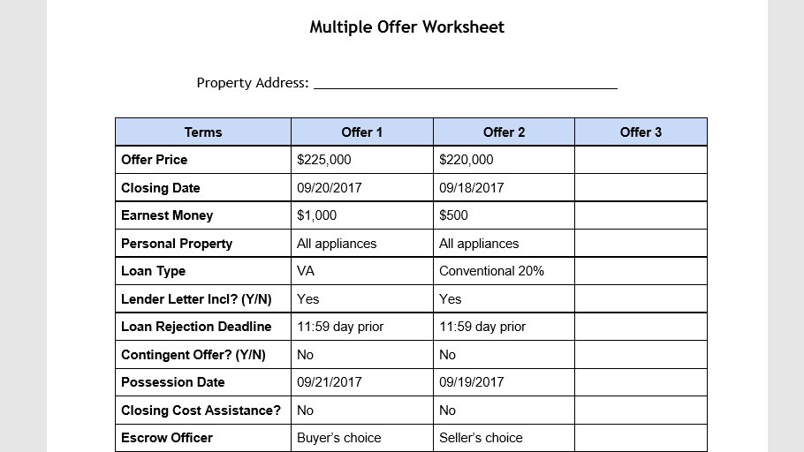

Slide 148
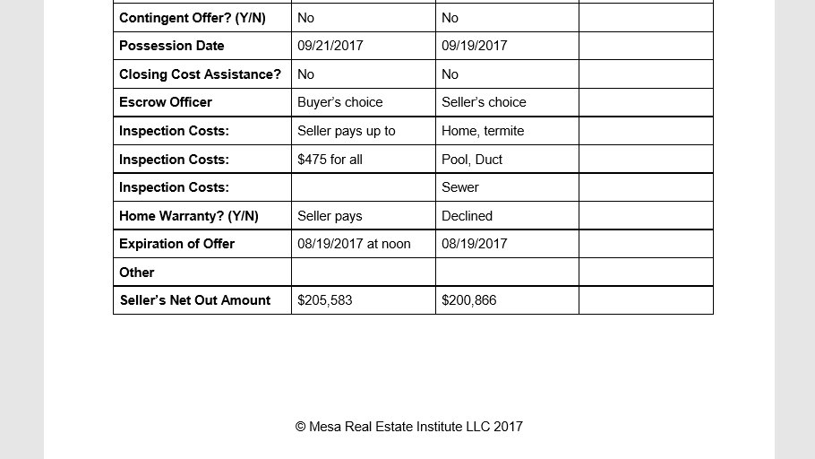

Slide 149
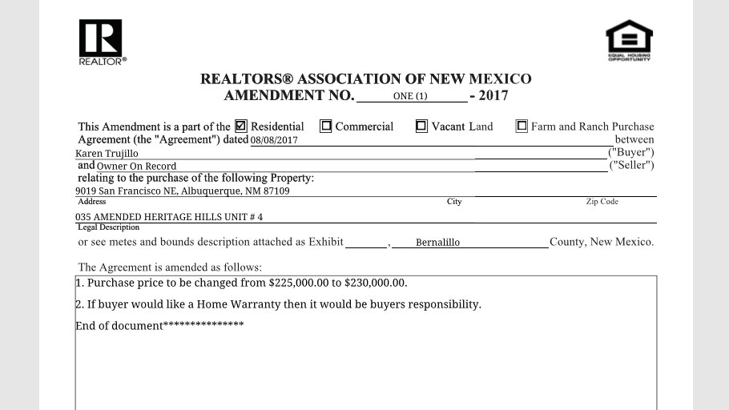

Slide 150
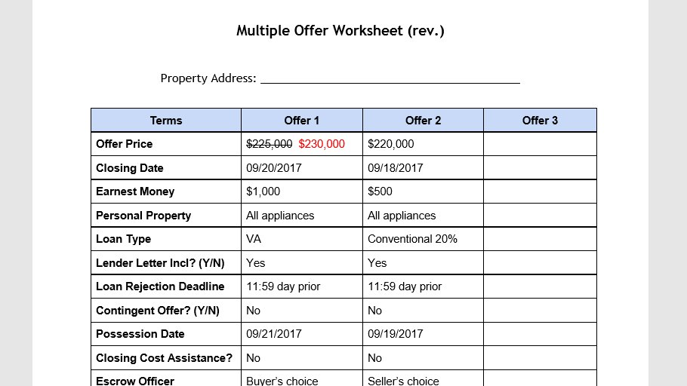

Slide 151
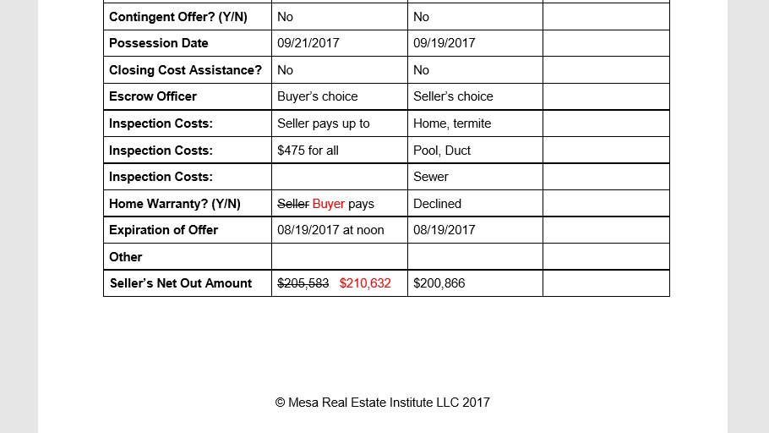

Slide 152
scenario #2

Slide 153
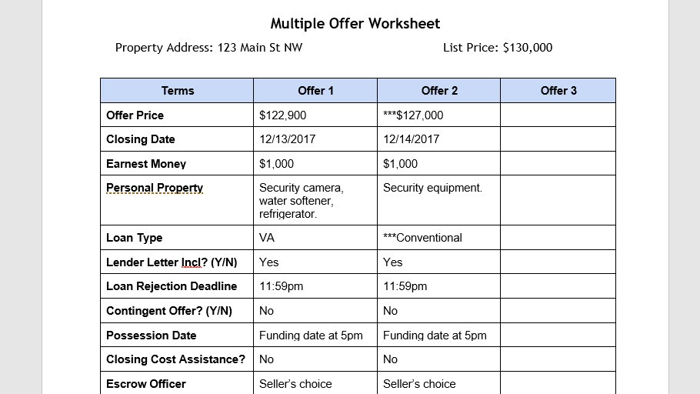

Slide 154
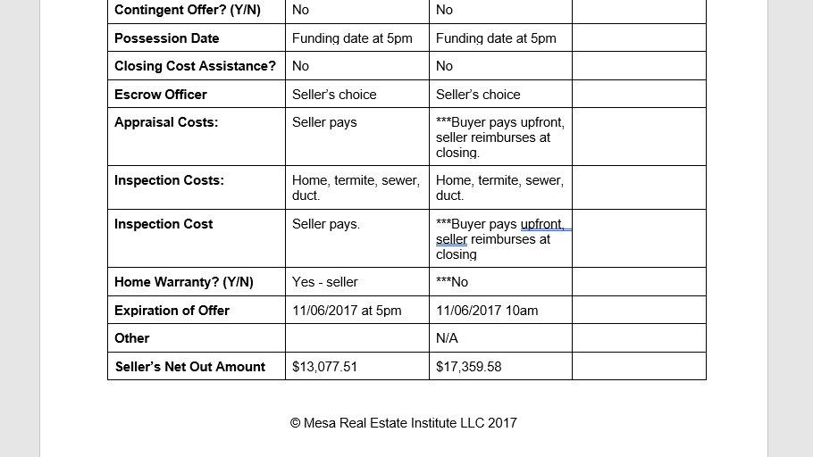

Slide 155
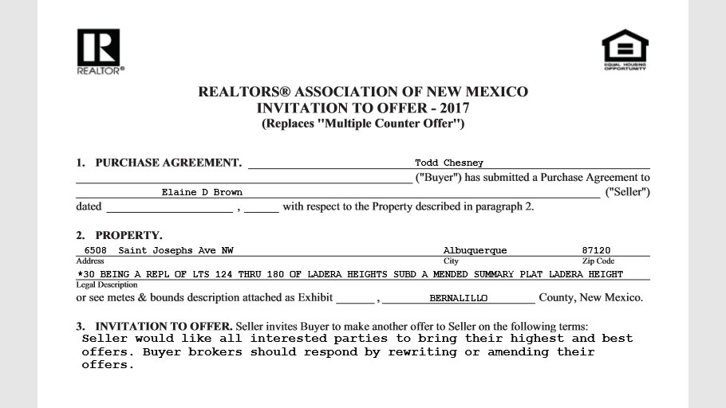

Slide 156
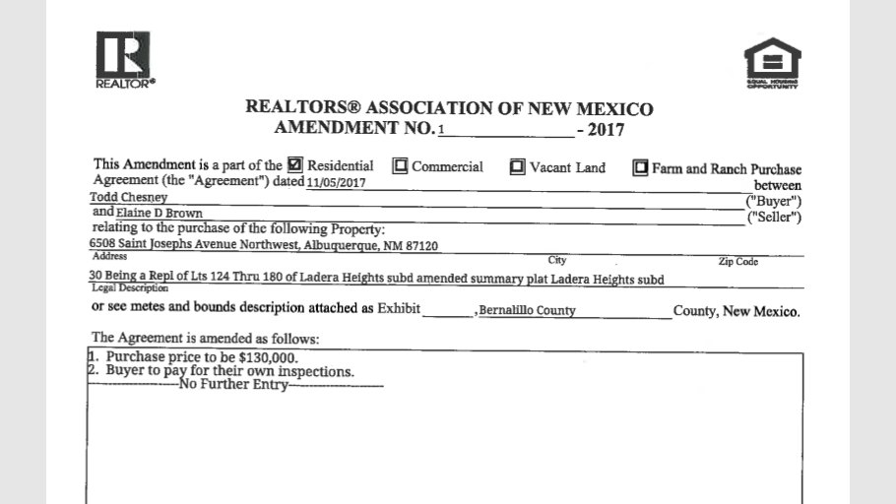

Slide 157
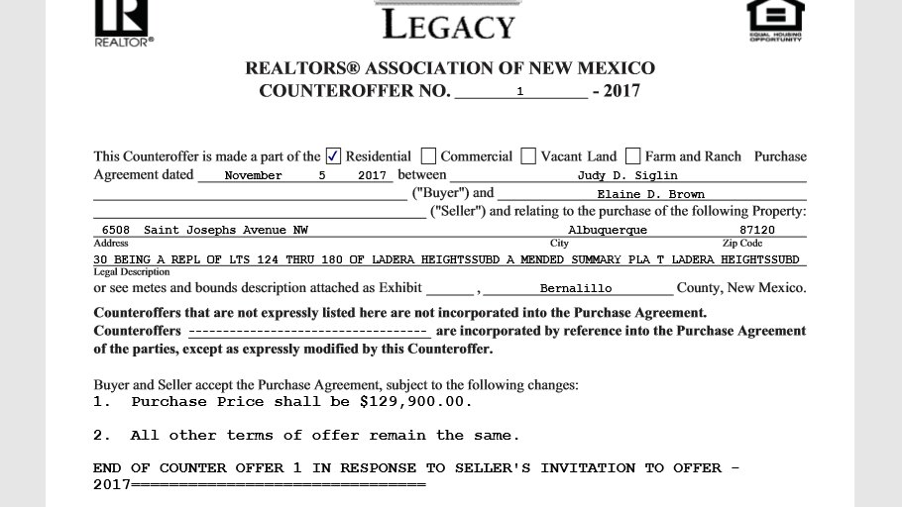

Slide 158
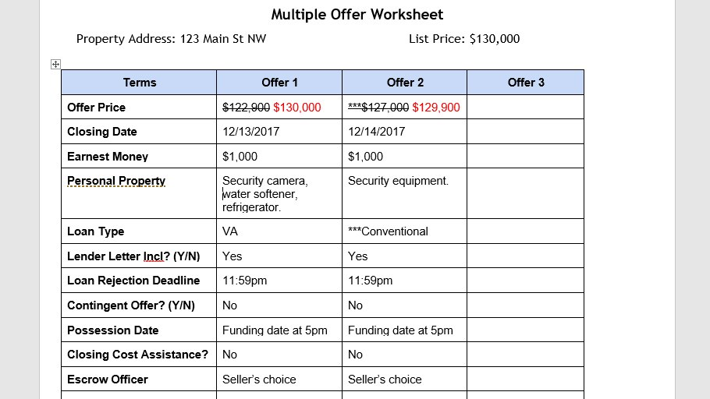

Slide 159
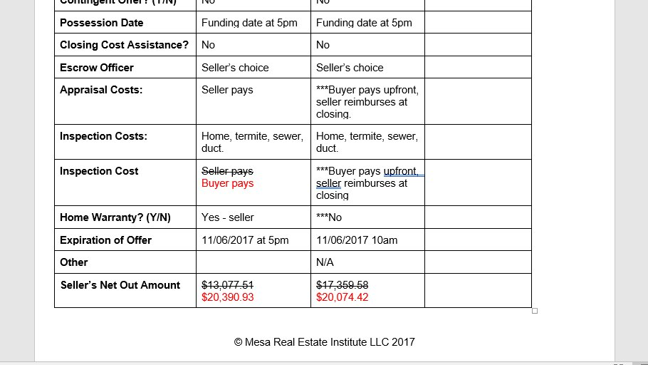

Slide 160
How to win at multiple offers

Slide 161
How to win at multiple offers
Help your buyers understand the market.
Educate them on market conditions, specifically the absorption rate and what a seller’s market is.
Set them up with a FlexMLS portal so they can see how fast the good homes are selling – sometimes in 2 or 3 days.
Run a CMA of the neighborhood and show the LP/SP Ratio.

Slide 162
How to win at multiple offers
Tell them stories about people who’ve lost out by offering less than list price. Stories help them connect the dots.
Set an expectation of offering list price or more

Slide 163
How to win at multiple offers
Help your buyers understand the multiple offer process
Explain the seller’s options when the receive multiple options
Explain the highest and best scenarios, procedures and strategies
Set the expectation that it’s going to be very competitive and they have to want to WIN!

Slide 164
How to win at multiple offers
Make your offer appealing to the seller
Minimize out-of-pocket expenses
Buyer to pay for the appraisal upfront
Buyer to pay for their own inspections upfront
Buyer to pay for their own warranty
Offer the seller a three-day rent back to facilitate their move
Have your buyers write a heart-felt letter

Slide 165
How to win at multiple offers
Don’t write in unnecessary details that will elicit a counter!
Closing officer
The loan rejection deadline
Unreasonably fast closing dates
Don’t leave blanks unfilled

Slide 166
Escalation clauses and multiple offers

Slide 167
What is an Escalation clause?
An escalation clause…. or… escalator, lets a home buyer say "I will pay x price for this home, but if the seller receives another offer that's higher than mine, I'm willing to increase my offer to y price." In theory, an escalation clause is fairly simple. In practice, there are a lot of details involved.
From “What is an Escalation Clause and When Should You Use One?” Written by Sam DeBord and published on Realtor.com, June 27, 2013.

Slide 168
What is an escalation clause?
Three basic components
What is the original offer or purchase price?
How much will that price be escalated above any other competitive bid? $2,000? $5,000?
What is the maximum amount that the purchase price can reach in case of multiple offers?

Slide 169
What is an escalation clause?
“For example, buyer Brown offers $100,000 for a home. Her Realtor adds an escalation clause that, in the case of a higher competing offer, will increase Brown's offer in increments of $2,000 above the competing offer. Her escalation clause goes up to a maximum of $110,000.”

Slide 170
What is an escalation clause?
“If no other offers are submitted, Brown's offer remains at $100,000. If buyer Green offers the seller $103,000, then Brown's offer would automatically escalate to $2,000 above that, bringing Brown's offer to $105,000. If buyer Orange offers $111,000 for the home, then Brown's maximum of $110,000 will be eclipsed, and Orange will have the top offer.”

Slide 171
What is an escalation clause?
Sample Language:
"In the event of multiple offers, Buyer agrees to pay $_____________ higher than the next highest offer, not to exceed $____________.
Seller or Seller's Agent to provide copy of next highest offer purchase agreement."

Slide 172
What is an escalation clause?
Sample Language: A better approach?
"In the event of multiple offers, Buyer agrees to amend their offer so that the seller will NET $__________ more than the next highest offer, with a sales price not to exceed $____________.
Seller or Seller's Agent to provide copy of the Purchase Contract including any amendments/addendums for the next highest offer."

Slide 173
What is an escalation clause?
Are escalation clauses common in our market?
How much should you escalate?
How will the seller view the offer?
Will the property appraise?
Does the listing broker get to show the buyer the next best offer?

Slide 174
Love letters: invitation to discrimination

Slide 175
Course review

Slide 176
Course review
What did you learn today?
Take 3 or 4 minutes and list the three most interesting things we discussed today.

Slide 177
Course Objectives
Identify the articles in the NAR Code of Ethics that are especially relevant to multiple offer situations
Identify the Broker Duties that are especially relevant to multiple offer situations
Apply the principles in the COE and Broker Duties to multiple offer situations to insure licensees are practicing in a professional and ethical manner

Slide 178
Course Objectives
Identify best practices (professionalism) in multiple offer situations to treat all parties honestly. Communication. RANM forms
Learn ways to win at multiple offer scenarios within the COE and Broker Duties

