Slide 1
Recent changes
RANM PURCHASE AGREEMENT

Slide 2
Purchase Agreement
Paragraph 4d: Fixtures
The property shall include all fixtures, free of all liens, unless otherwise noted, including but not limited to, the following fixtures if such fixture exists on the property…
Solar power system(s)/panels (if leased by seller, lien may exist)

Slide 3
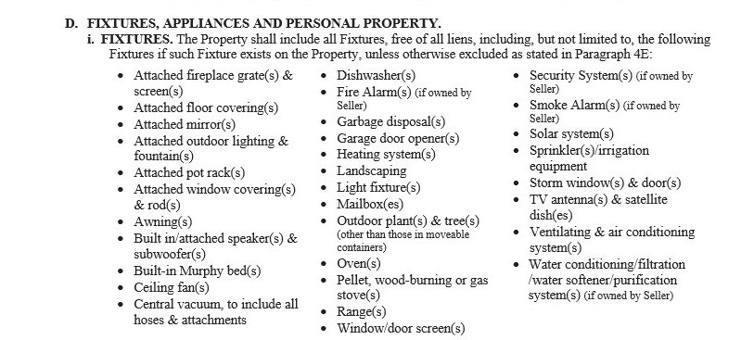

Slide 4
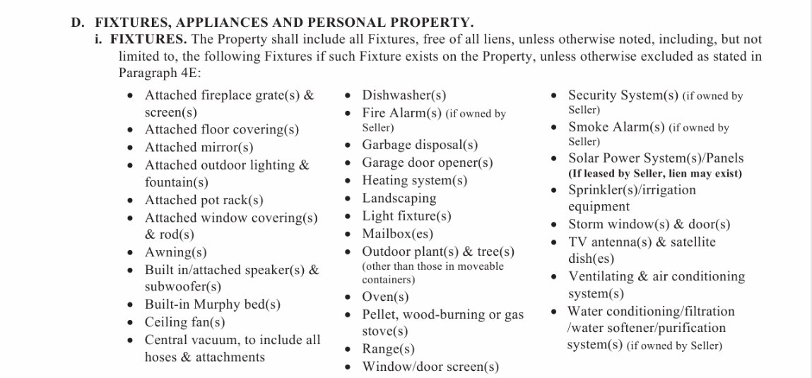

Slide 5
Purchase agreement
Paragraph 4d: Personal Property
The following personal property, if checked, shall remain with the property:
Freestanding ranges

Slide 6
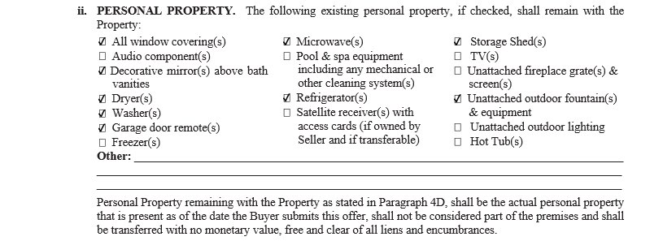

Slide 7
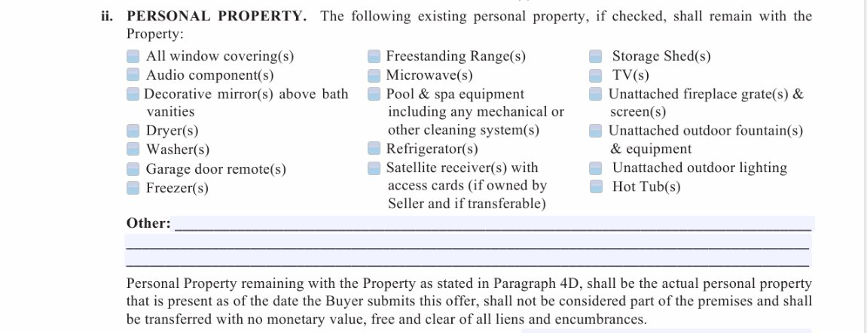

Slide 8
Purchase agreement
Paragraph 5: Financed or Cash Purchase
The first check box has been removed, so this now defaults to 11:59pm the day before closing unless you fill in the blank!

Slide 9
Old version

Slide 10
New version

Slide 11
Purchase agreement
Paragraph 8b: Funding Date
Inserted the phrase “funding date requirements”

Slide 12
Old version

Slide 13
New version

Slide 14
Purchase agreement
Paragraph 9: Possession Date
Check box has been added which gives possession to the buyer once funding date requirements have been met

Slide 15
Old version

Slide 16
New version

Slide 17
Purchase agreement
Paragraph 9B: Possession Date
New language inserted: “or the date the property is surrendered to buyer per a seller occupancy agreement”
and
“In the event seller fails to remove all debris and garbage from the property, seller shall be liable to buyer for all costs associated with removal of such debris and garbage.”

Slide 18
Old version

Slide 19
New version

Slide 20
New version

Slide 21
Purchase agreement
Paragraph 12: Prorations
New language inserted:
“to include any remaining propane gas therein”

Slide 22
Old version

Slide 23
New version

Slide 24
Purchase agreement
Paragraph 17h: Documents
Added to the document grid:
Solar power systems/panels

Slide 25
Old version

Slide 26
New version

Slide 27
Purchase agreement
Paragraph 20i: Resolution
New language inserted:
(collectively “seller’s Response”). Buyer may not withdraw his objections and terminate this agreement prior to Seller’s Response;

Slide 28
Old version

Slide 29
New version

Slide 30
Purchase agreement
Paragraph 22: Disclaimer
The following language has been removed
And is purchasing Property based solely upon Buyer’s inspection and judgement and not by reason of any representation made to buyer by seller or broker unless expressly set forth in this agreement or disclosure statements.

Slide 31
Old version

Slide 32
New version

Slide 33
Purchase Agreement
Paragraph 40: Buyer and Seller Authorizations
The following Language has been inserted:
the Title Company to deliver any Title Company generated settlement statement(s), in its entirety (Seller and Buyer’s information) to both the Seller and Buyer and their respective Brokers;

Slide 34
Old version

Slide 35
New version

Slide 36
Purchase agreement
AFTER PARAGRAPH 43 AND Above the buyer’s signature
WIRE FRAUD LANGUAGE HAS BEEN ADDED

Slide 37
OLD VERSION

Slide 38
NEW VERSION

Slide 39
Seller’s property disclosure
Section N4: Insurance Claims
New language has been inserted:
If seller did receive proceeds, did seller used proceeds to repair or correct the issue that was the subject matter of the claim?

Slide 40
Old version

Slide 41
New version

Slide 42
Seller’s property disclosure
N9: Lawsuits
New item added to this section:
Lawsuits RE: components of property

Slide 43
New item

Slide 44
Seller’s property disclosure
Section O:
Entirely new section added
Prior Inspection Report

Slide 45
New Section

Slide 46
Septic system contingency Addendum
RANM 5120A

Slide 47
Septic system contingency addendum
Paragraph 1 - Reorganized and broken down in subsections A and B
1(A) – Clarifies that an evaluation is not required if a prior evaluation was conducted within 180 days prior to closing (wording on the old form was confusing/ambiguous).
1(B) – Explains that if an evaluation is conducted and property does not close for more than 180 days after evaluation, NMED may require an additional evaluation prior to transfer.
1(B)(i) – Reiterates language from the Purchase Agreement that even if the seller is paying for and/or ordering the septic evaluation, Buyer still gets to choose the evaluator.

Slide 48
Septic system contingency addendum

Slide 49
Septic system contingency addendum

Slide 50
Occupancy agreement – seller
RANM 2202

Slide 51
Occupancy Agreement – Seller (Ranm 2202)
Paragraph 4 – Payment. Was reorganized and broken down into 4 subsections.
4(A) – Deposit. Clarifies when Deposit will be refunded if there is no damage to the property.
4(B) – Occupancy Fee. Defines the compensation paid as a “fee” and not “rent.” The term “rent” created issues with the buyer’s lender on the Buyer’s Occupancy Agreement, so it was changed. For consistency, the same terminology was used in the Seller’s Occupancy Agreement.

Slide 52
Occupancy Agreement – Seller (Ranm 2202)
4(C) – New term “Holdover Charge.” In as attempt to clarify the significance and consequences of the Seller remaining in the Property past the agreed upon term.
4(D) Sets forth when deposits, the Occupancy Fees and the Holdover Fees are due.

Slide 54
Occupancy Agreement – Seller (Ranm 2202)

Slide 55
Occupancy agreement – Seller (RANM 2202)
Paragraph 6(A)
Added language advising Buyer to check with his/her insurance company regarding coverage after closing, but before seller vacates.

Slide 56
Occupancy agreement – Seller (RANM 2202)

Slide 57
Occupancy agreement – Seller (RANM 2202)

Slide 58
Occupancy agreement – buyer
RANM 2201

Slide 59
Occupancy agreement – buyer (RANM 2202)
Paragraph 3(D)
Refund of Deposit Language – Moved from Possession/Term Paragraph into Payment Paragraph.

Slide 60
Occupancy agreement – buyer (RANM 2202)

Slide 61
Occupancy agreement – buyer (RANM 2202)
Paragraph 4 – Payment. Reorganized into 4 subsections
4(A) – Deposit. Clarifies when deposit will be refunded if there is no damage to the property.
4(B) – Occupancy Fee. Defines the compensation paid as a “fee” and not as “rent.” The term “rent” created issues with the buyer’s lender, so it was changed herein.
4(C) – New term “Holdover Charge” created in an attempt to clarify the significance and consequences of seller remaining in the Property past the agreed upon term.

Slide 62
Occupancy agreement – buyer (RANM 2202)

Slide 63
Occupancy agreement – buyer (RANM 2202)
Paragraph 5
Clarifies that Buyer shall place utilities in Buyer’s name if it is allowed.

Slide 64
Occupancy agreement – buyer (RANM 2202)

Slide 65
Occupancy agreement – buyer (RANM 2202)
Paragraph 6(B)
Added language advising Seller to check with his/her insurance company when buyer occupies prior to closing.

Slide 66
Occupancy agreement – buyer (RANM 2202)

Slide 67
ORW
RANM 5109

Slide 68
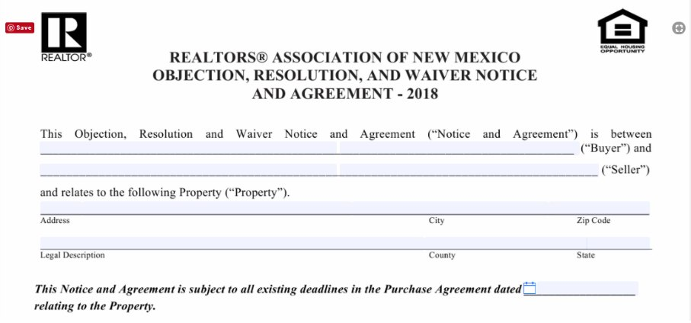

Slide 69
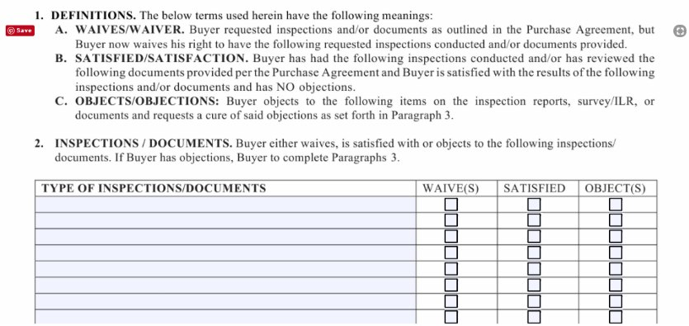

Slide 70
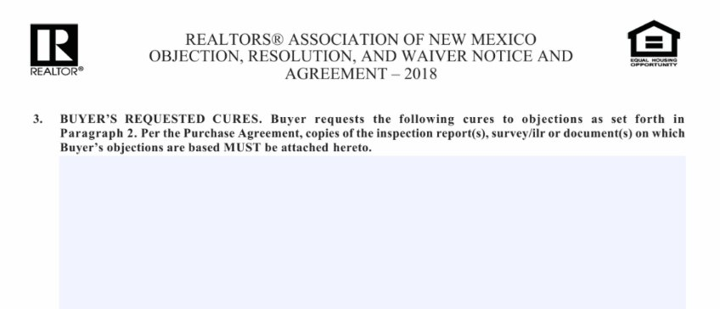

Slide 71
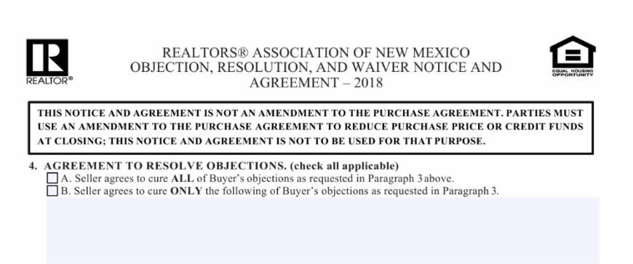

Slide 72
Price Modification /seller credits
RANM 2101

Slide 73
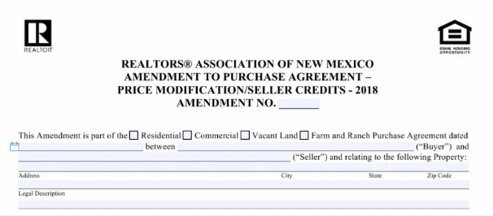

Slide 74
